Slide 1
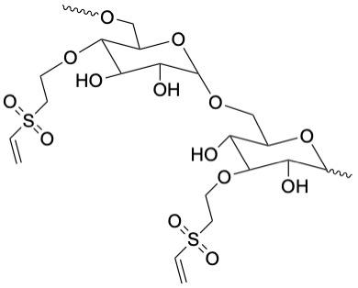
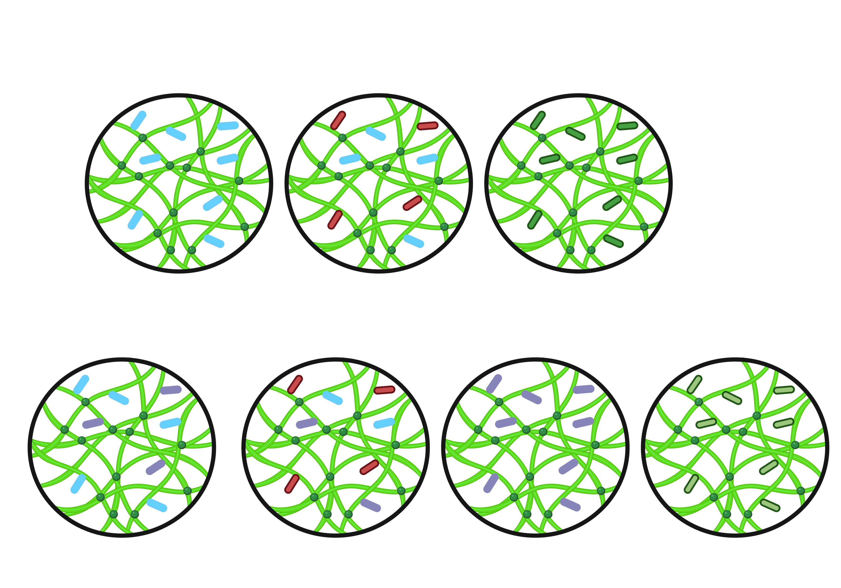
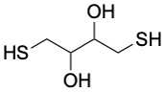
Figure 1
A
B
RGD
RSyn
IKVAV
C
Dextran
CRGDS
Vinyl
Sulfone
CGGRPREDRVPPSRNSITLTN
CSRARKQAASIKVAVSADR
DTT

Slide 2
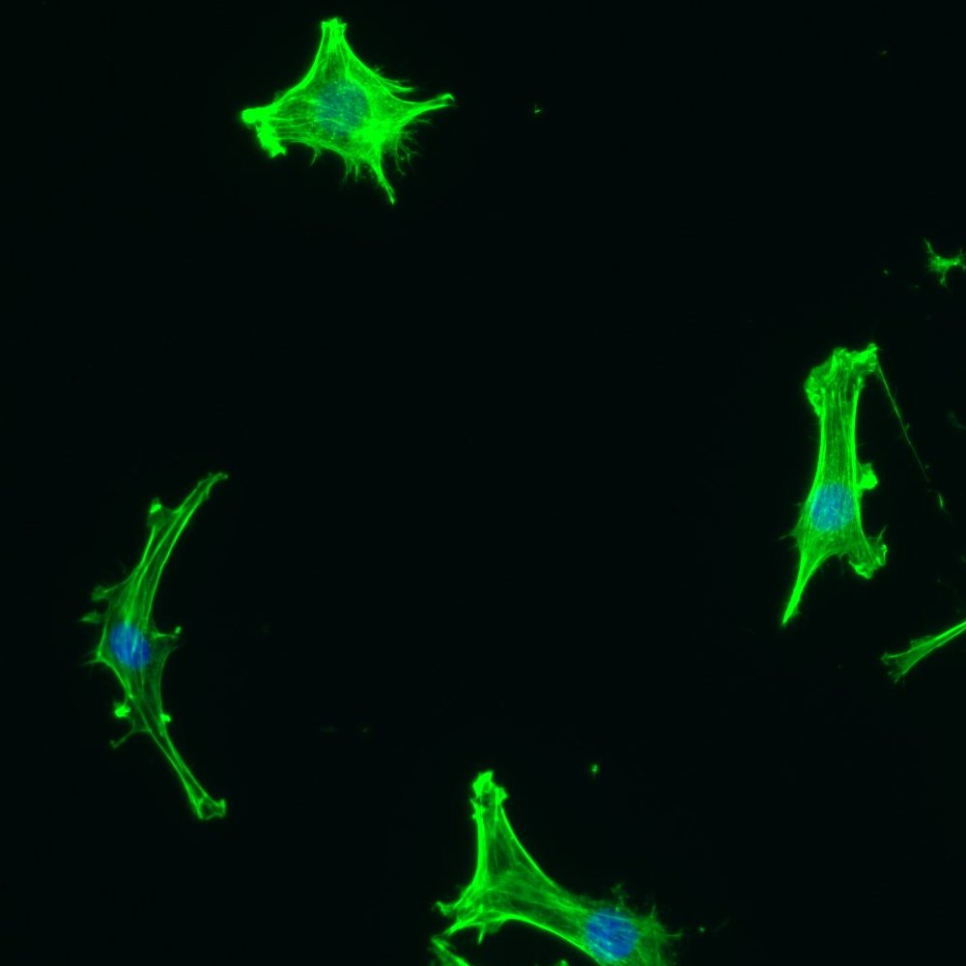
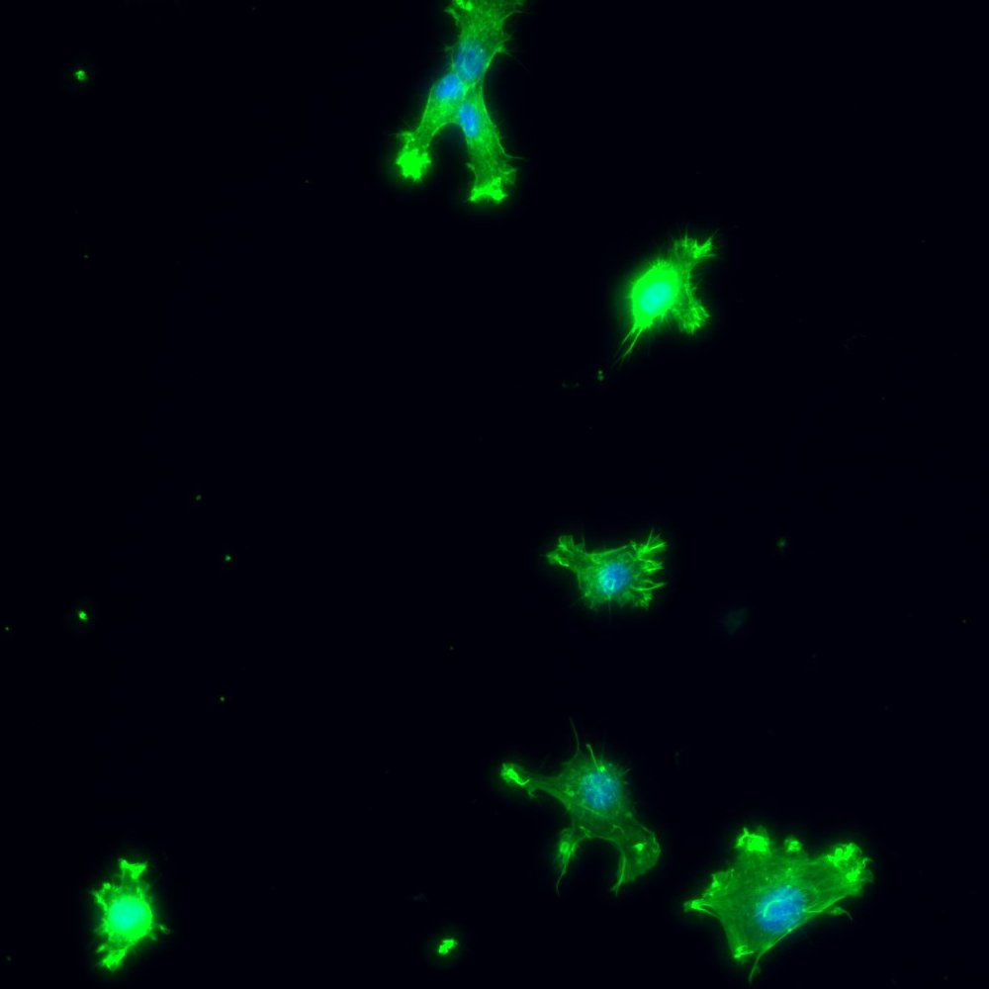
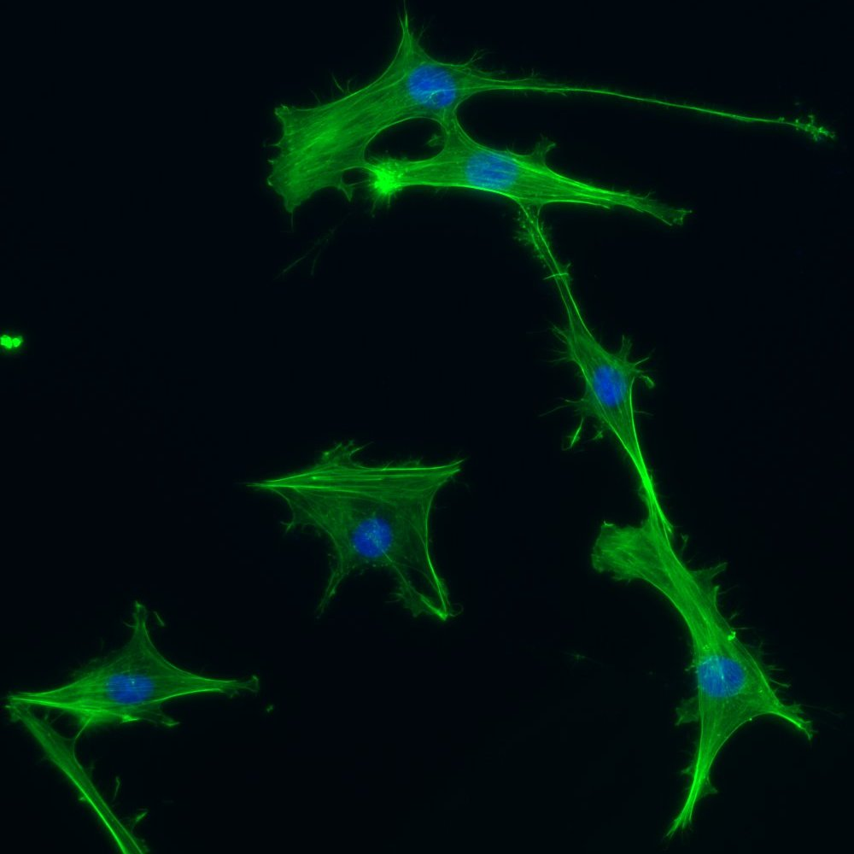
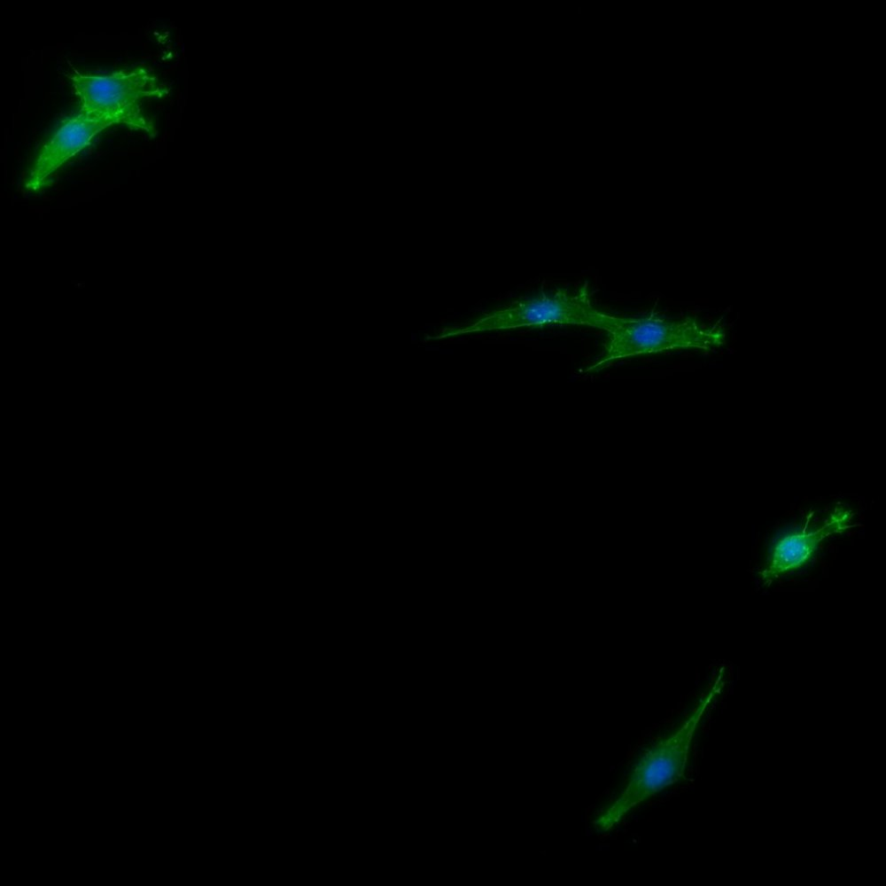
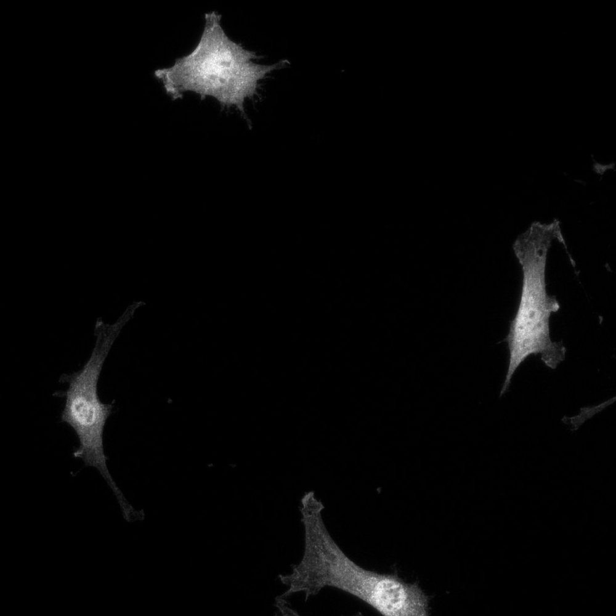
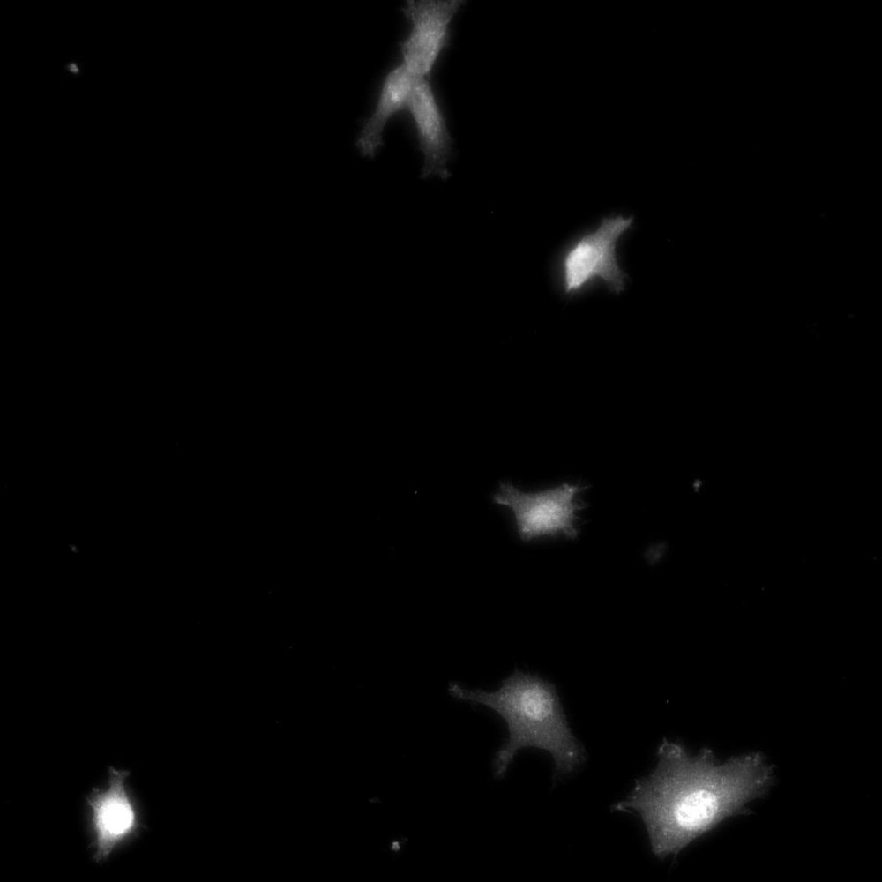
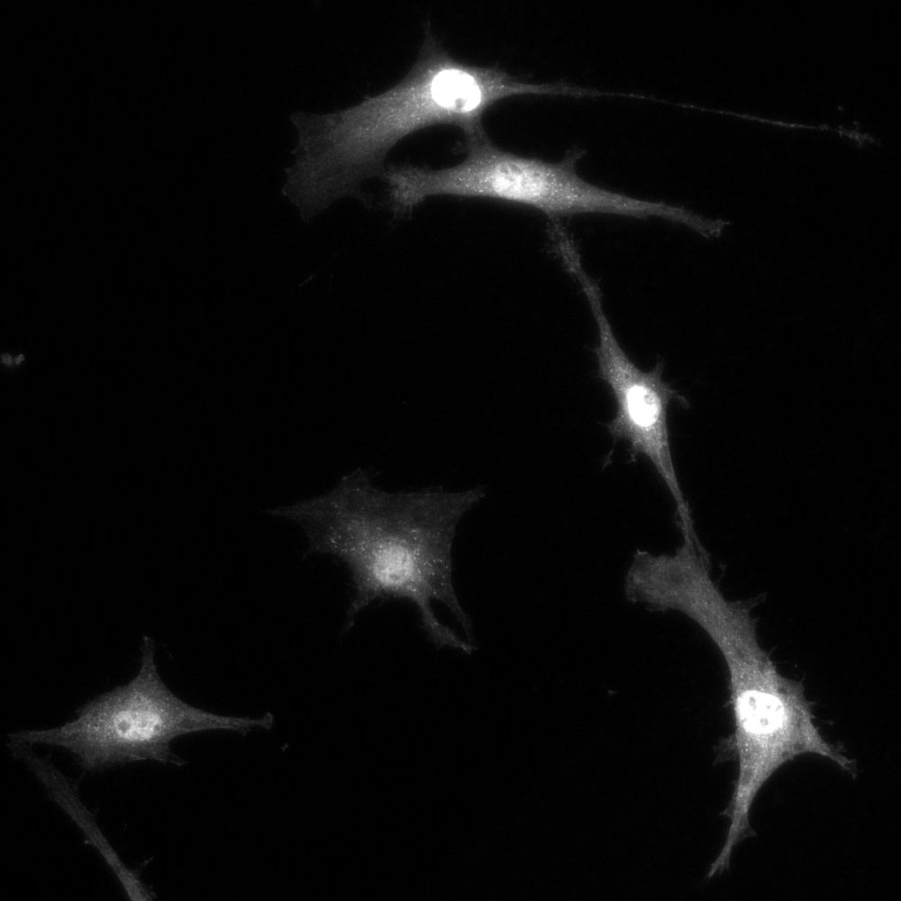
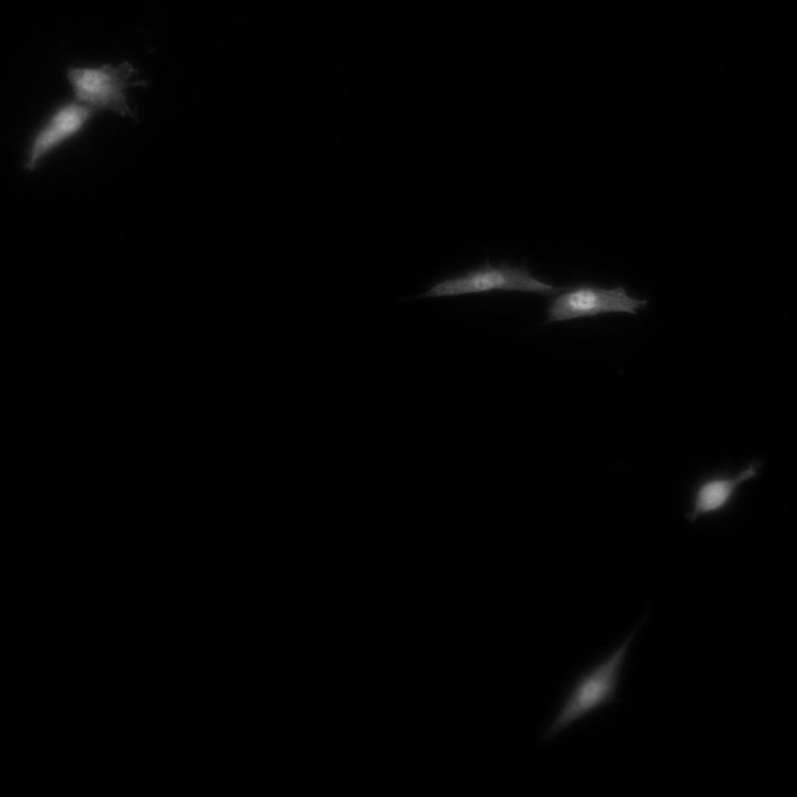
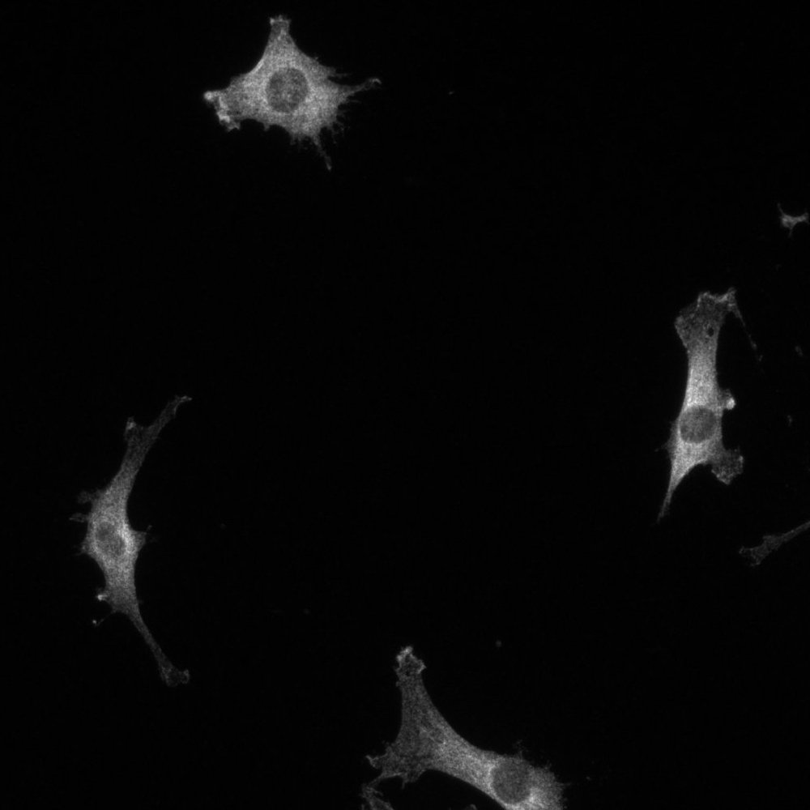
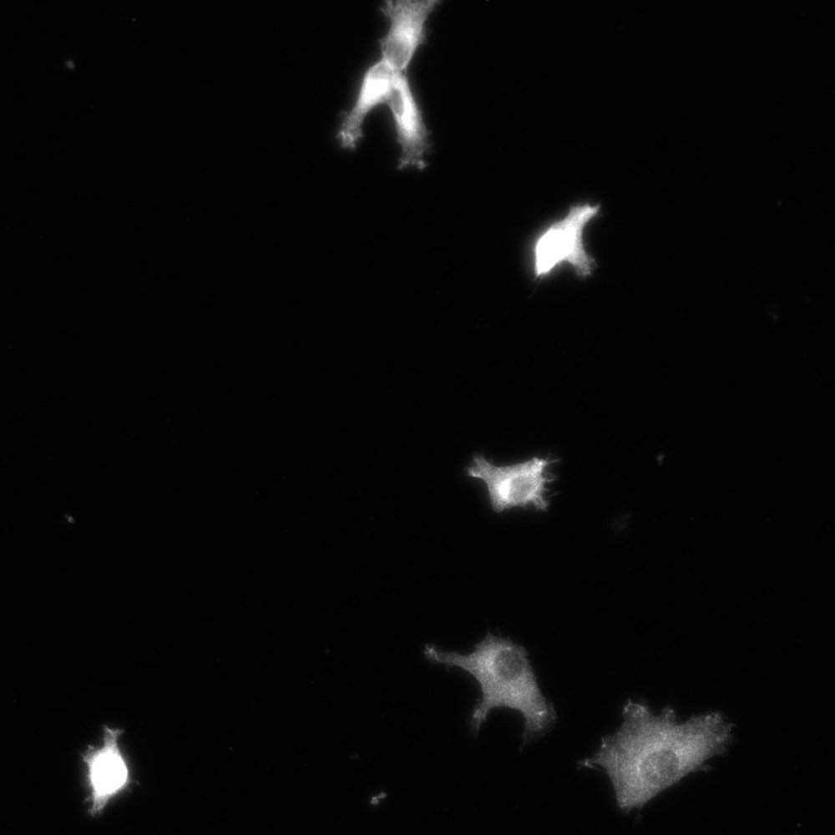
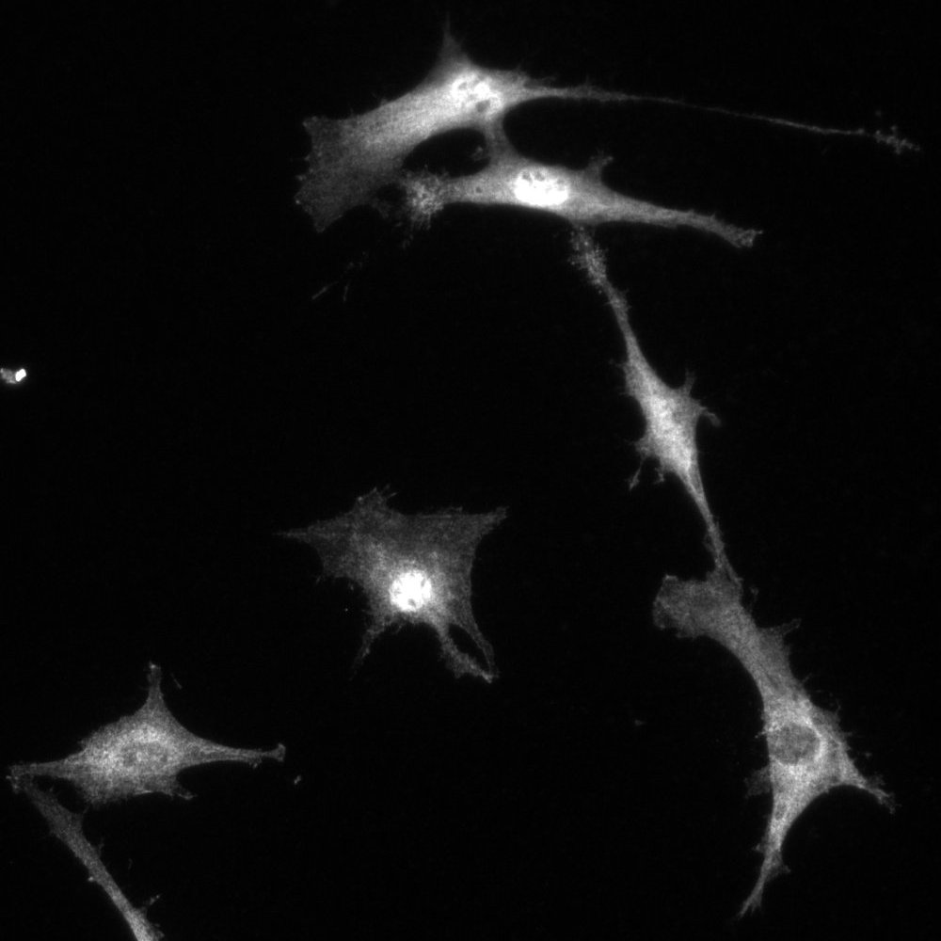
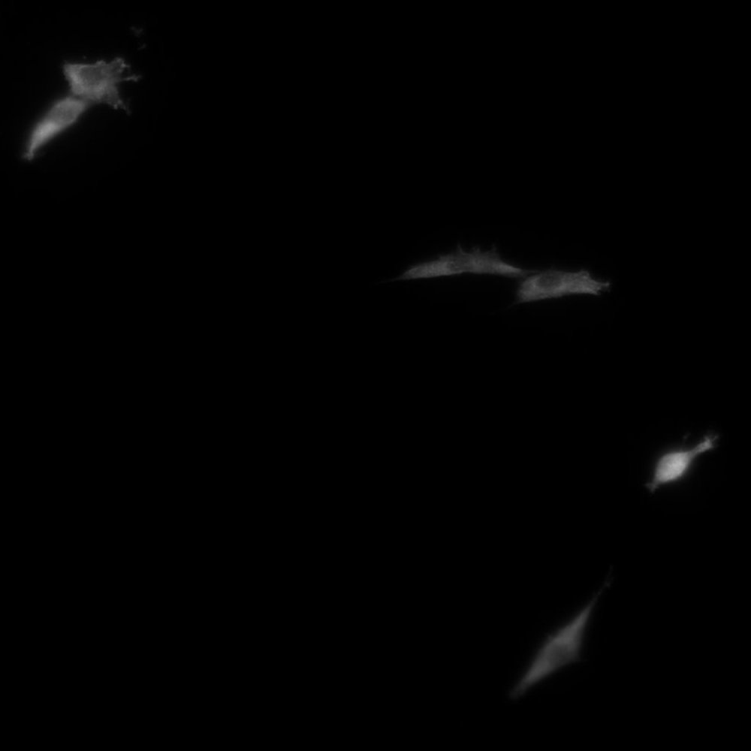
Figure 2
A
B
C
D
E
RGD
Syn
RSyn
IKVAV
F-Actin/DAPI
YAP
p65

Slide 3
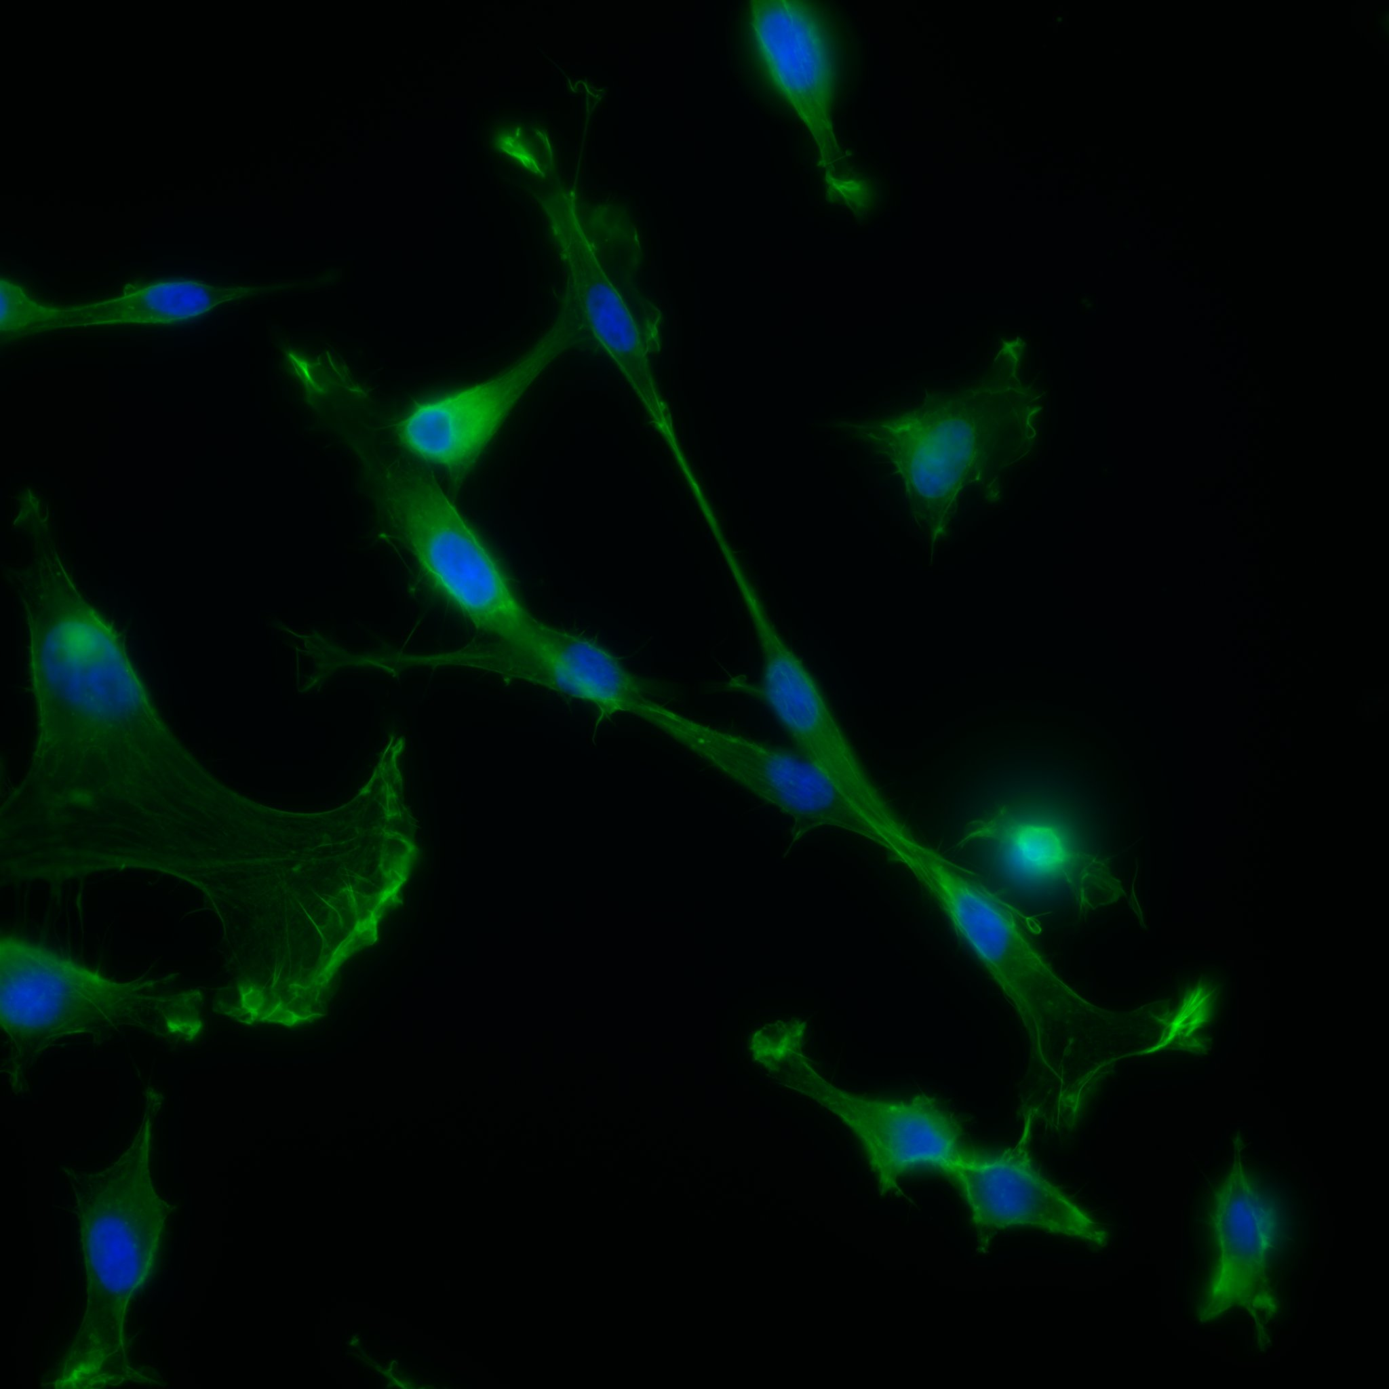
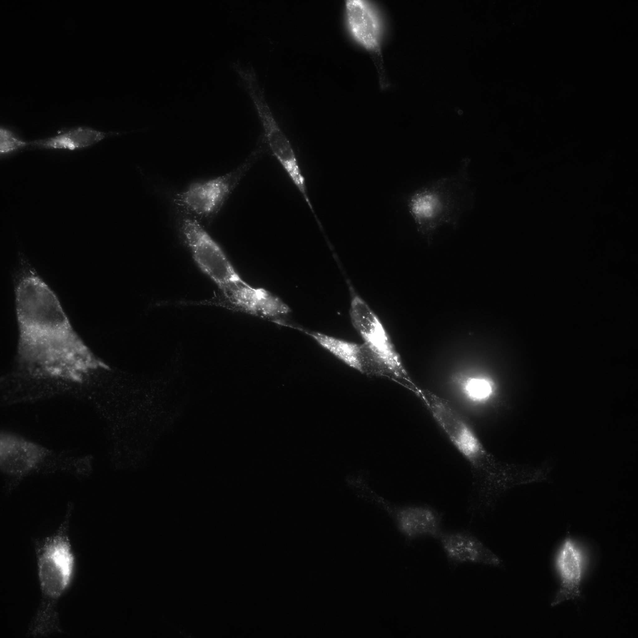
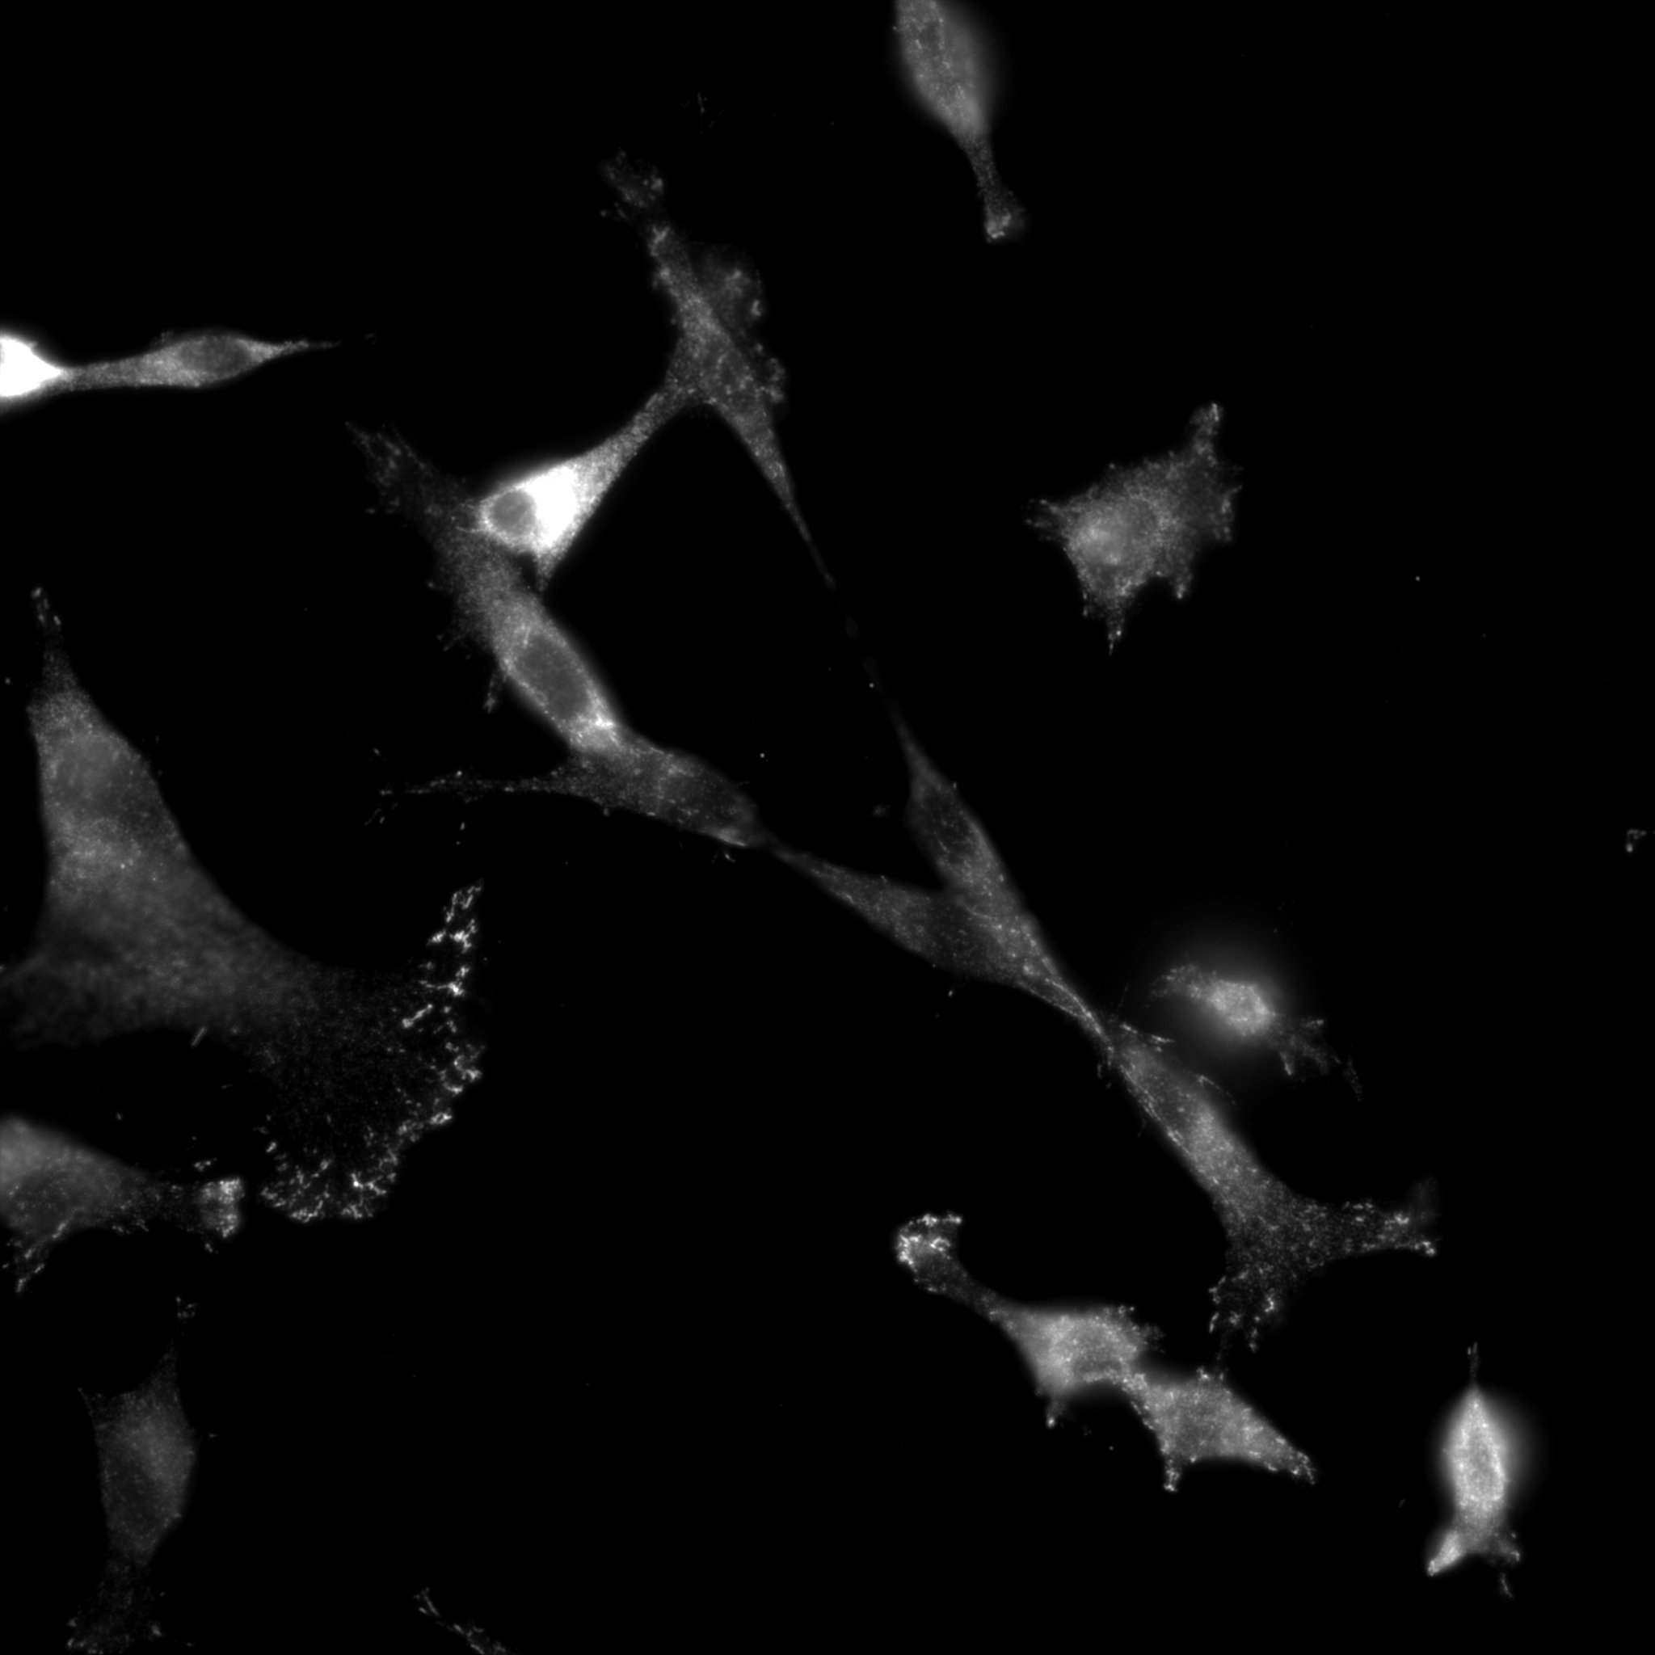
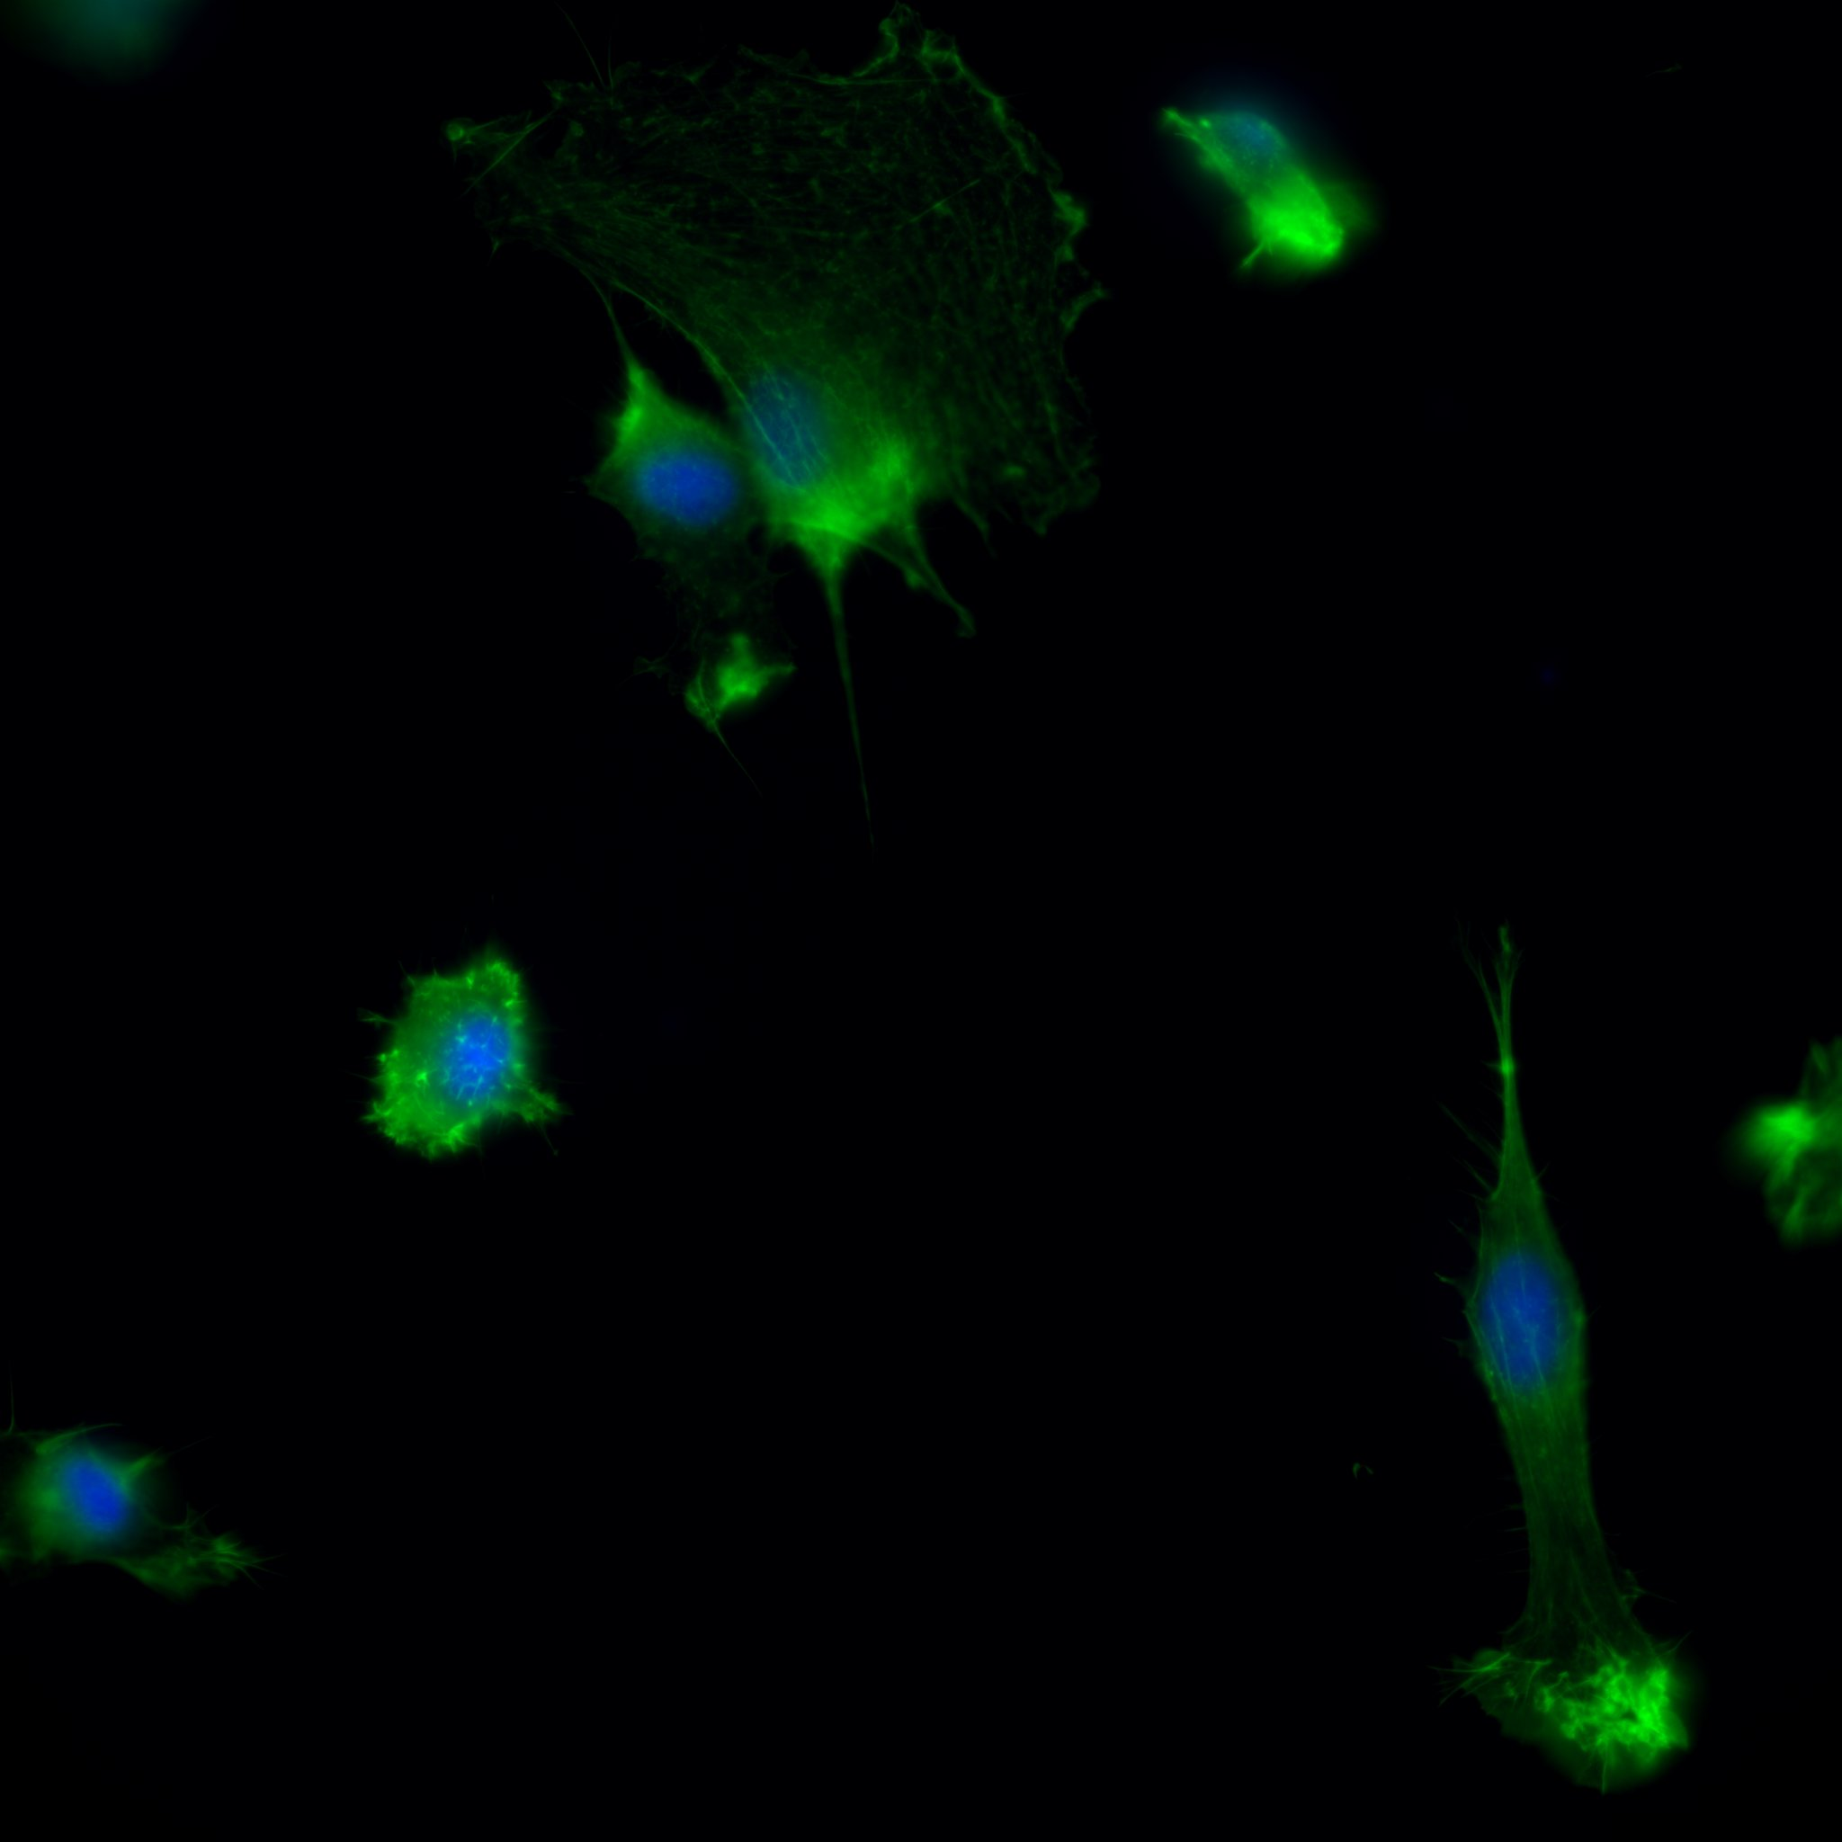
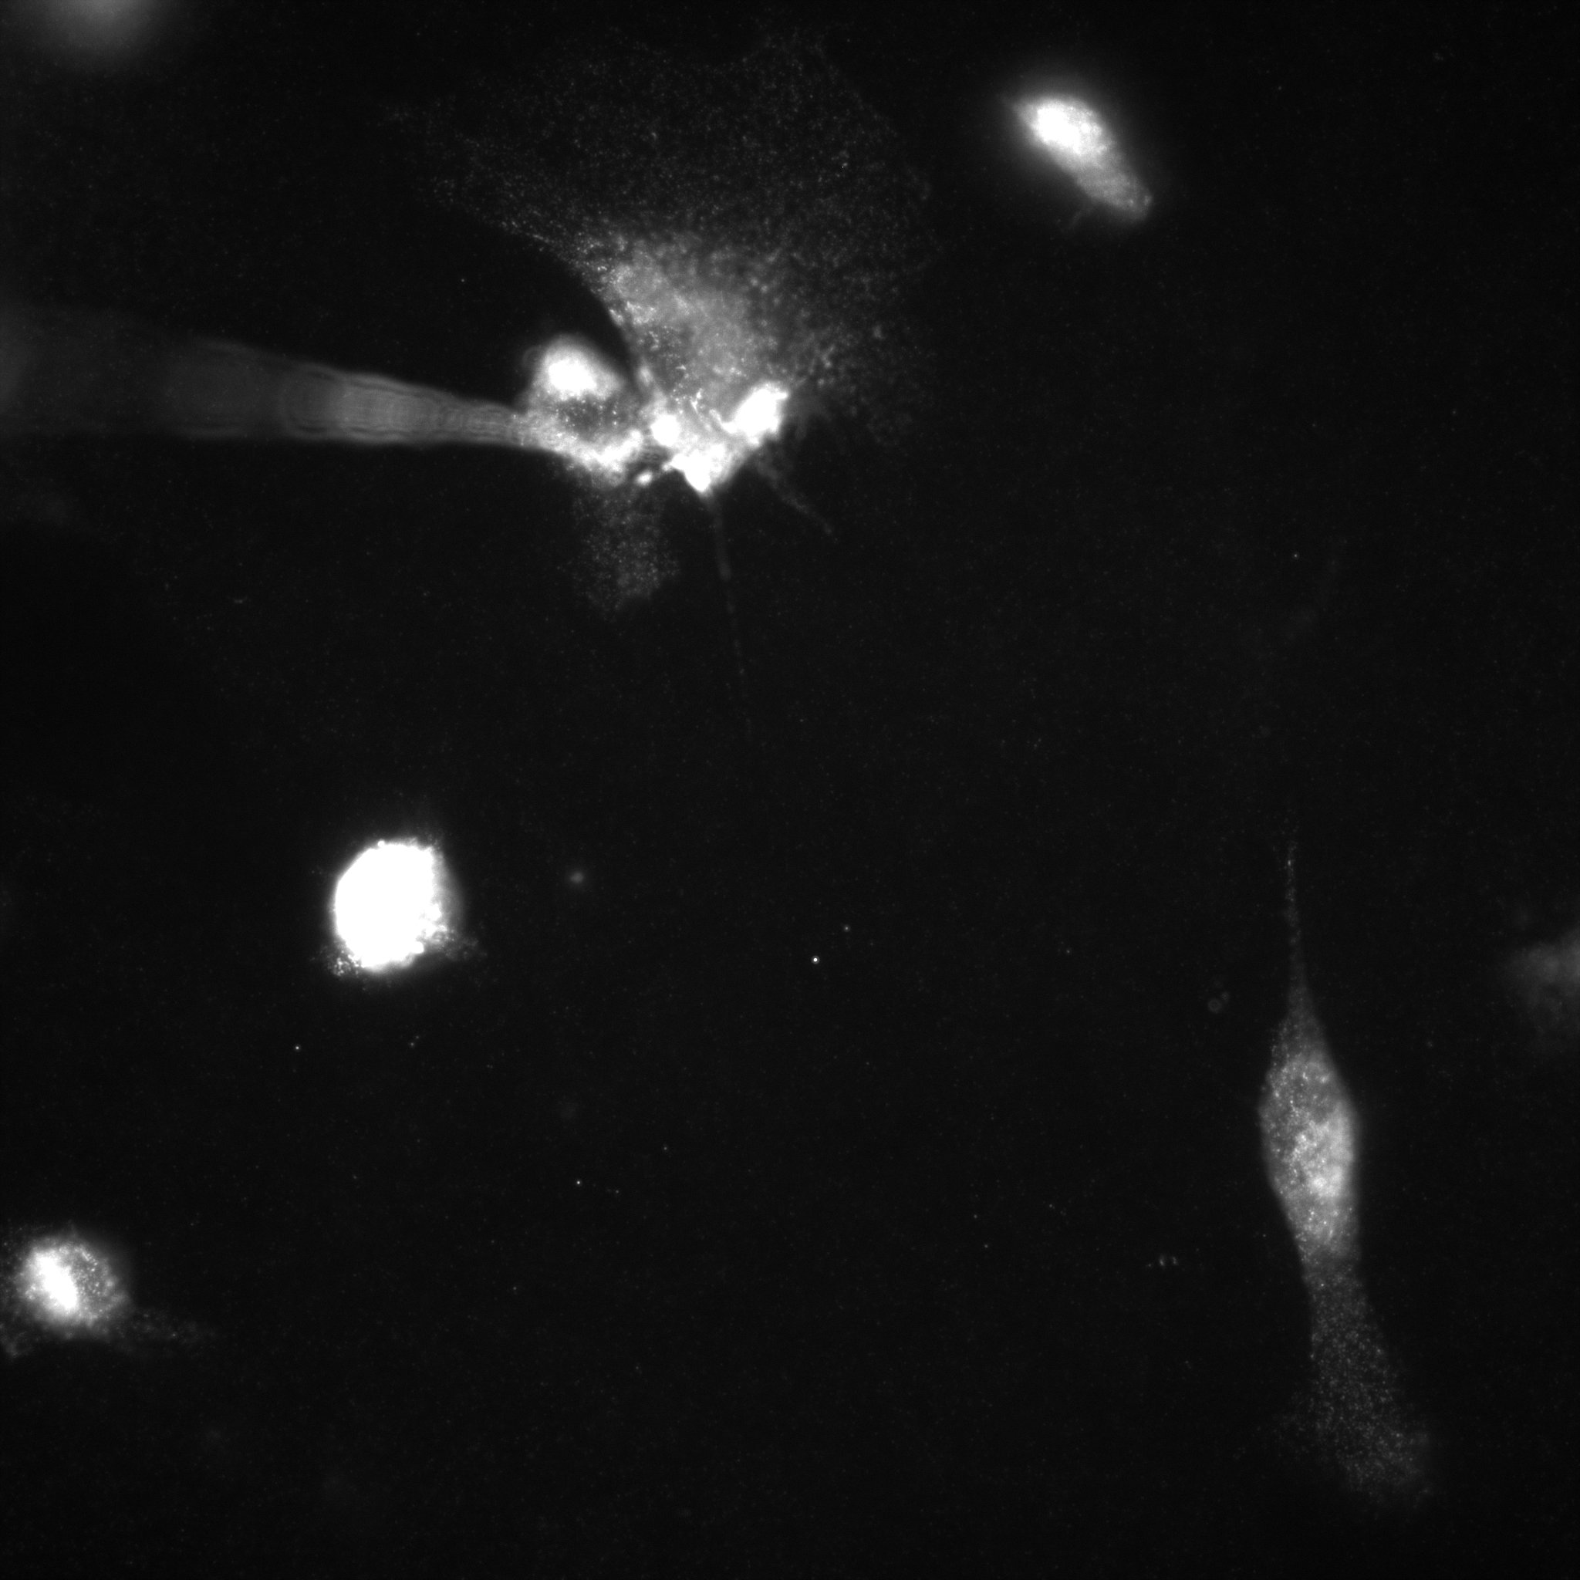
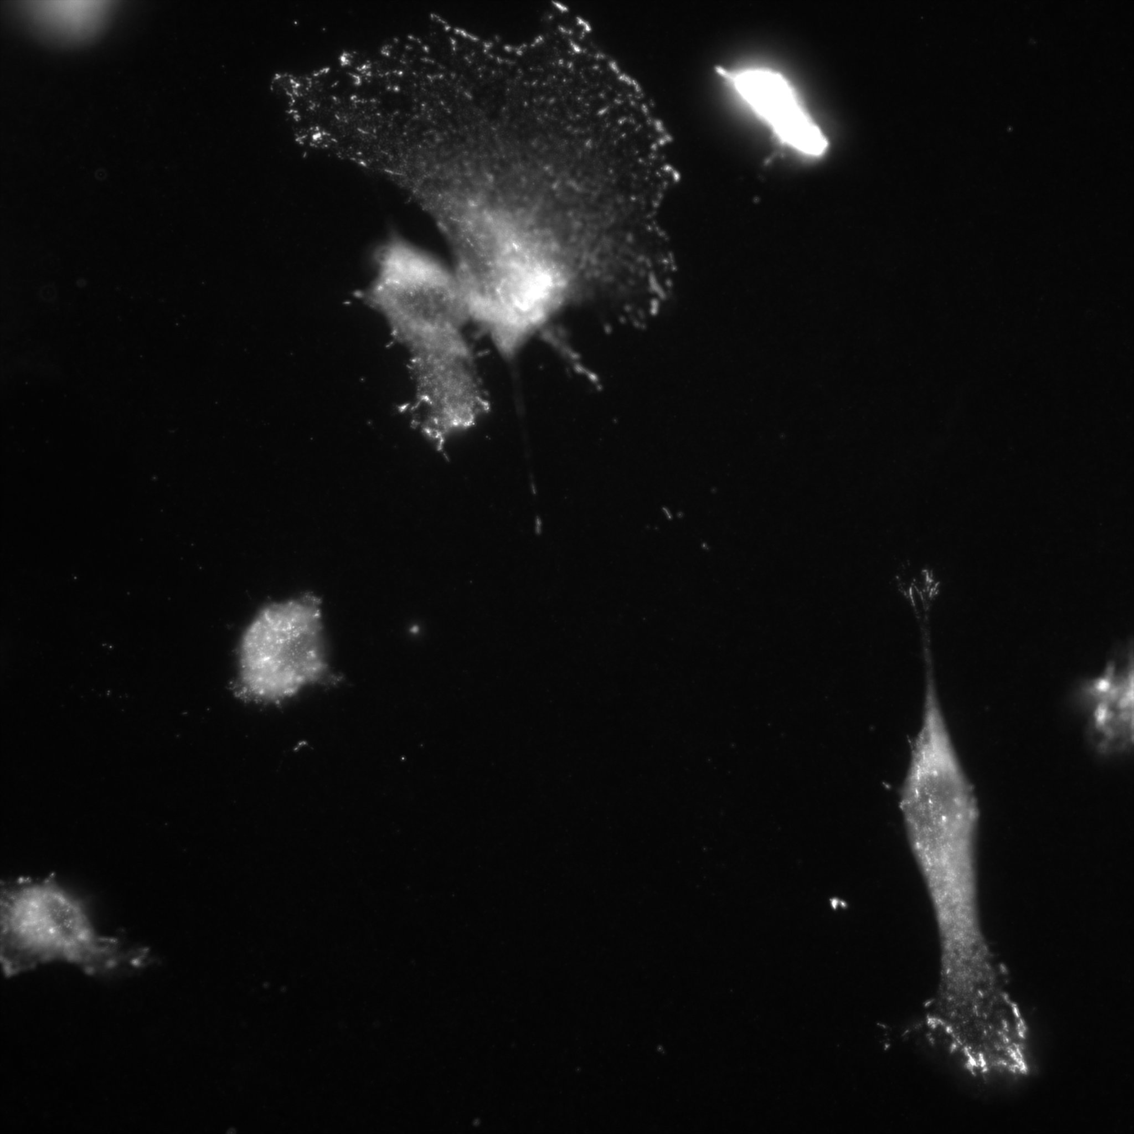
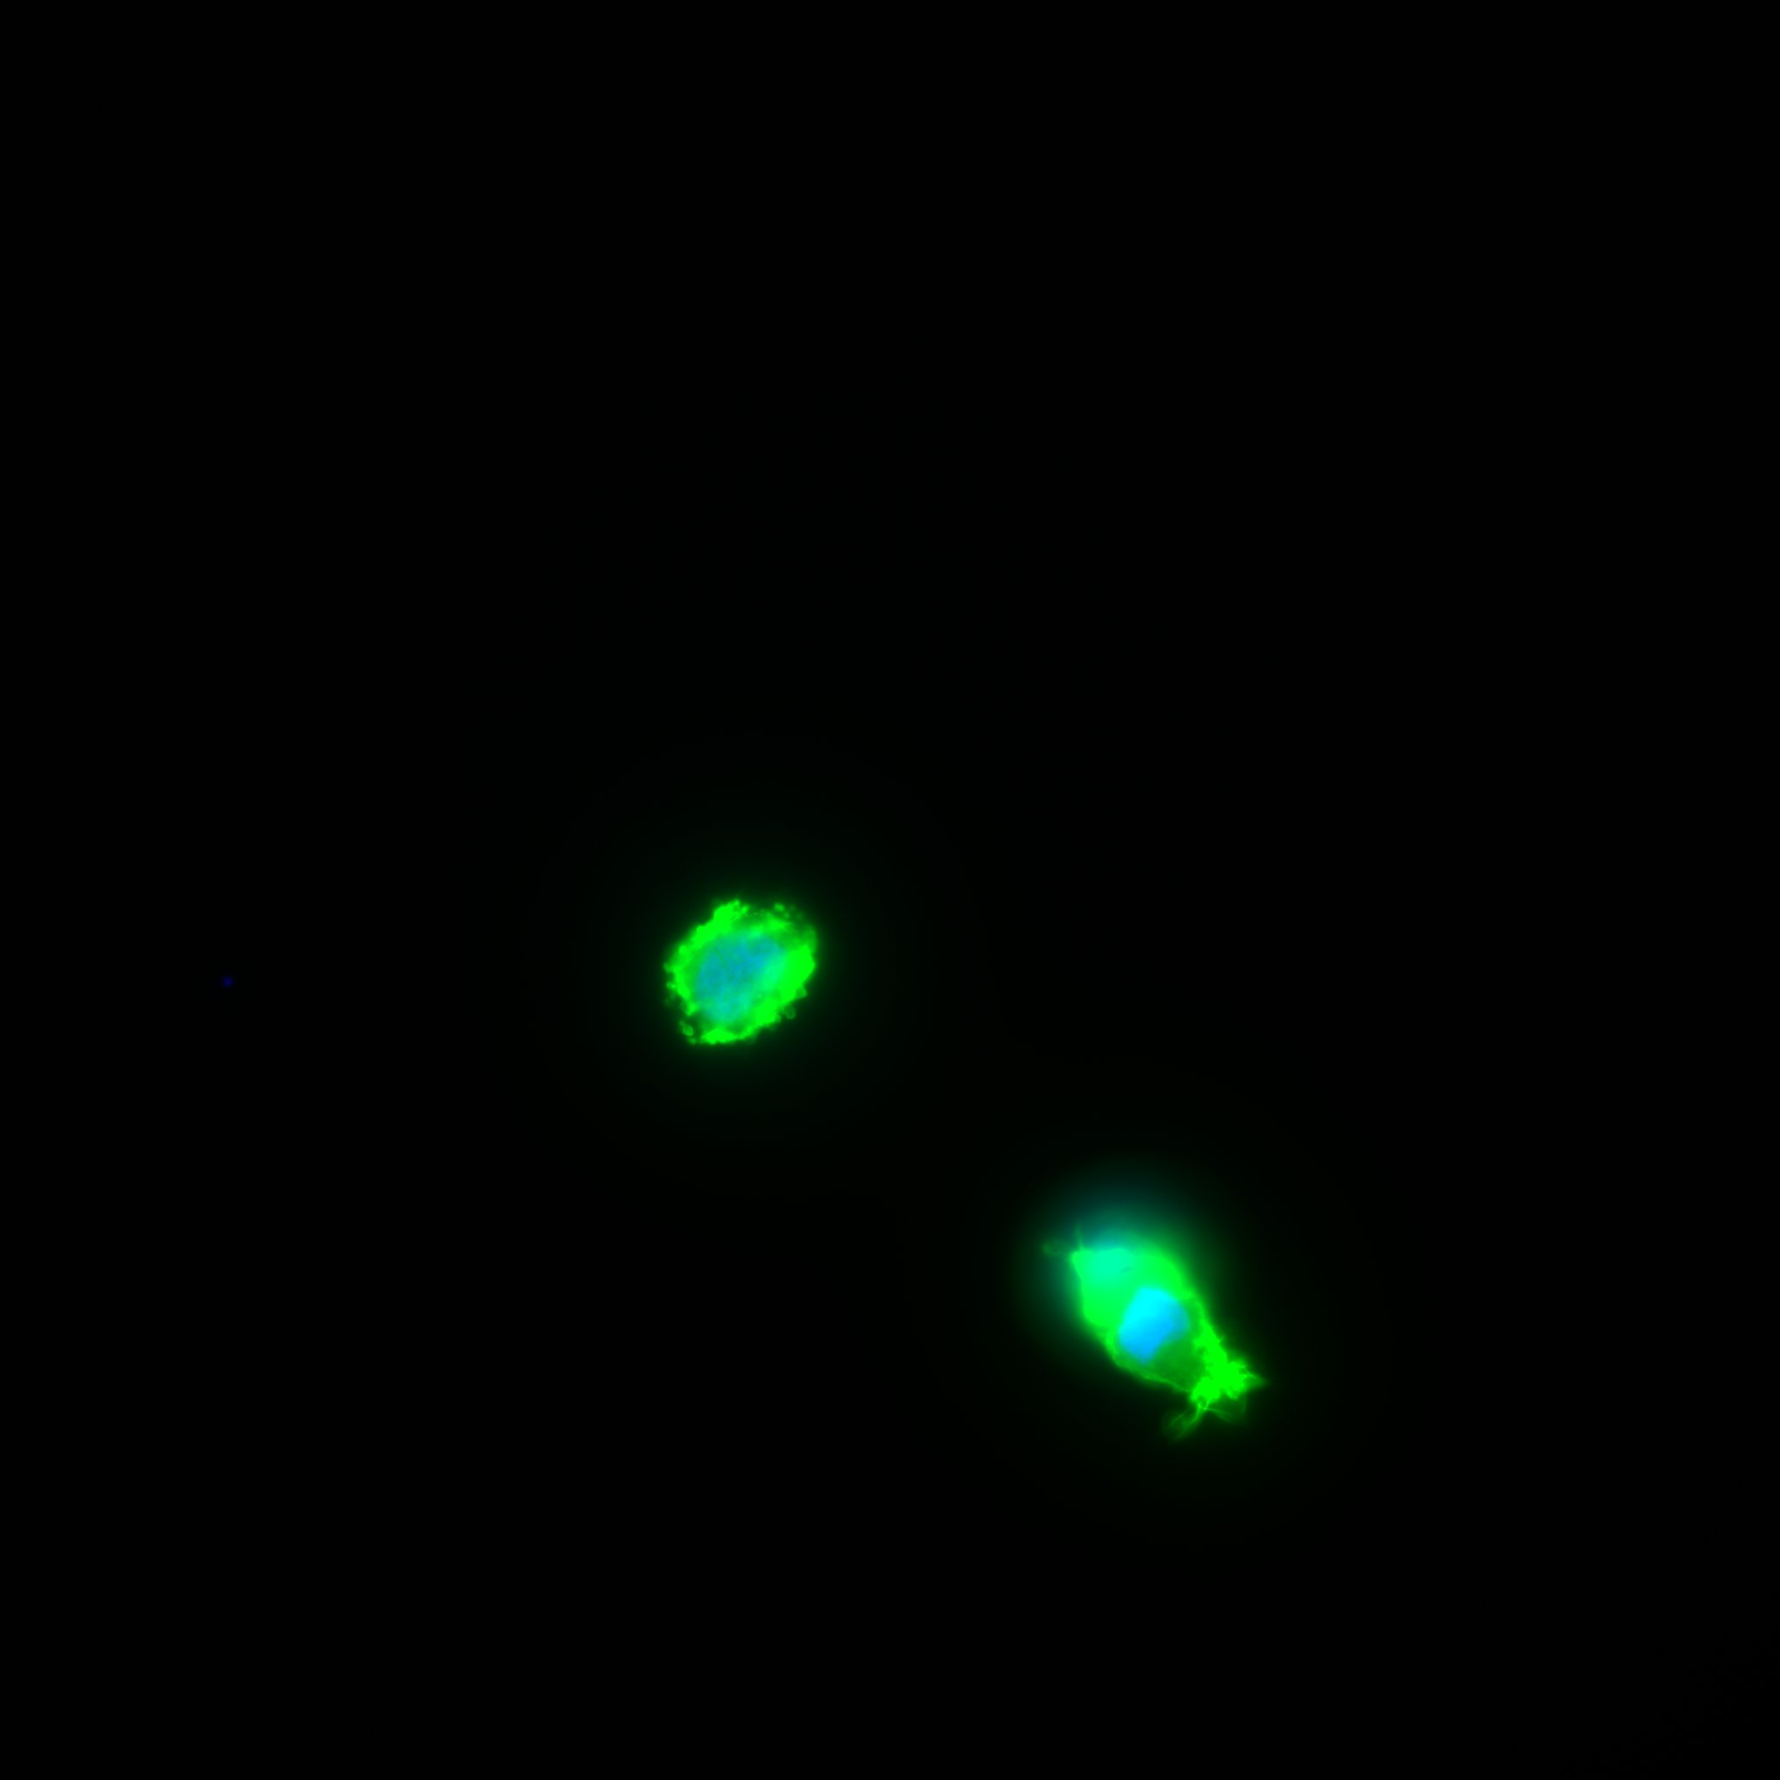
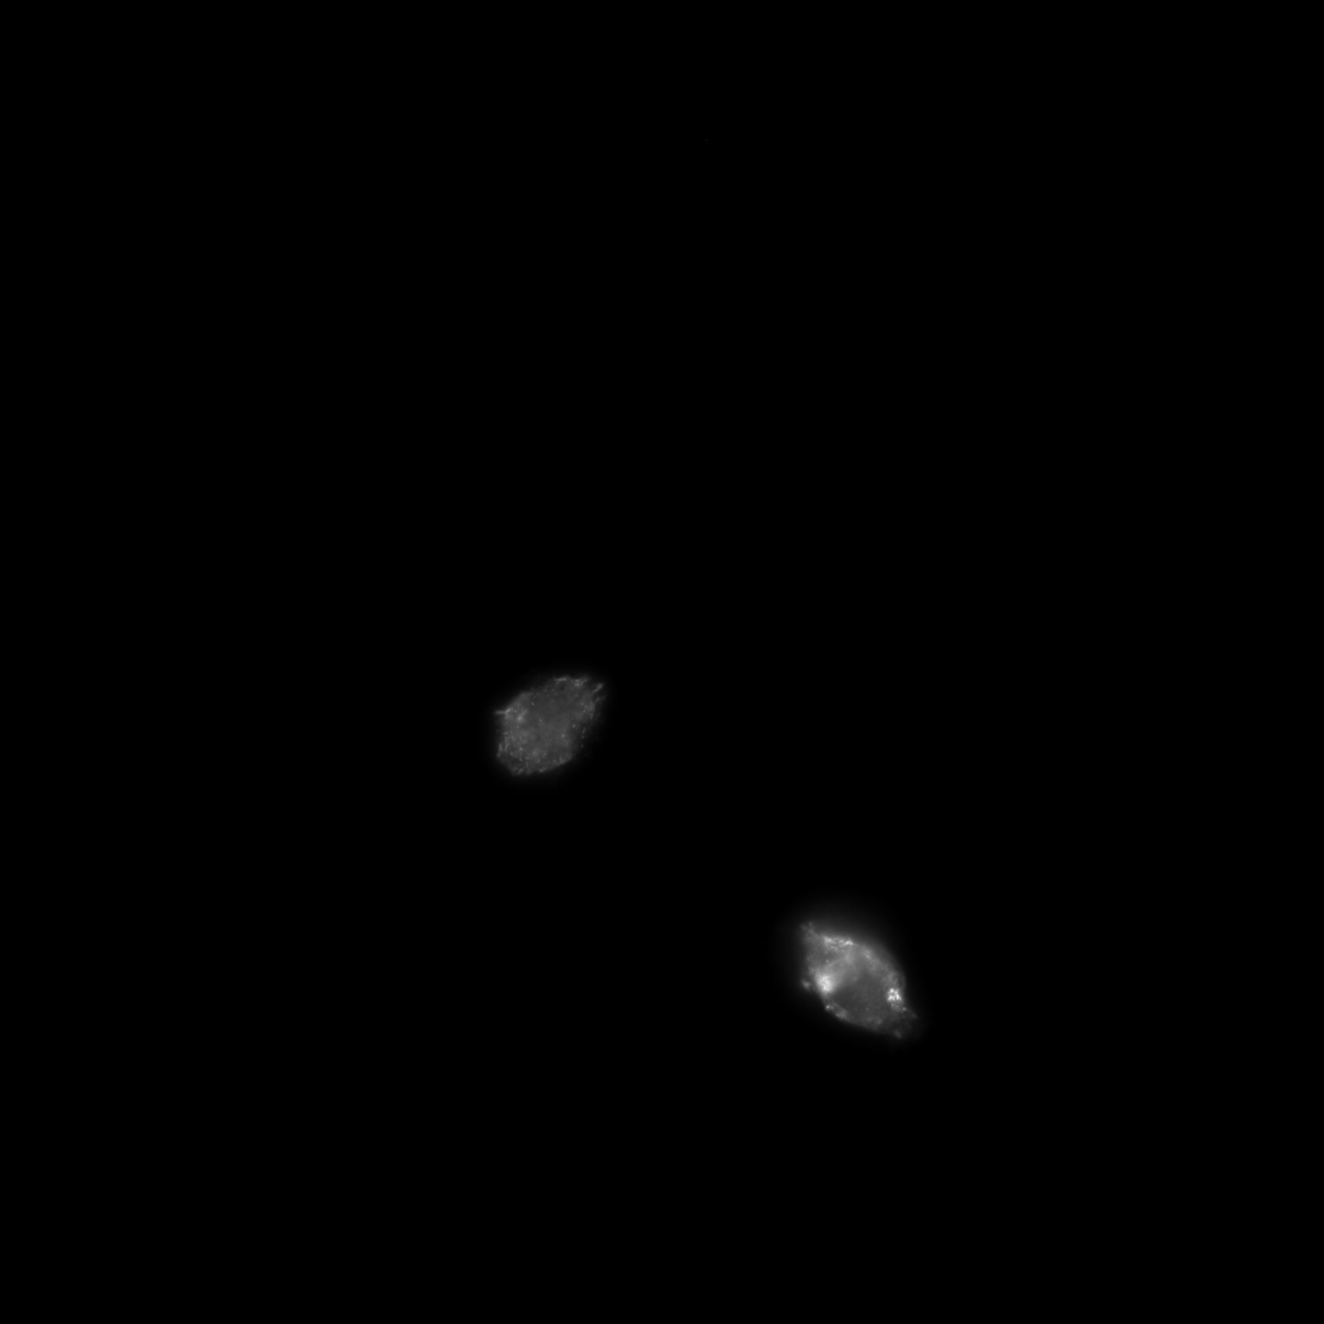
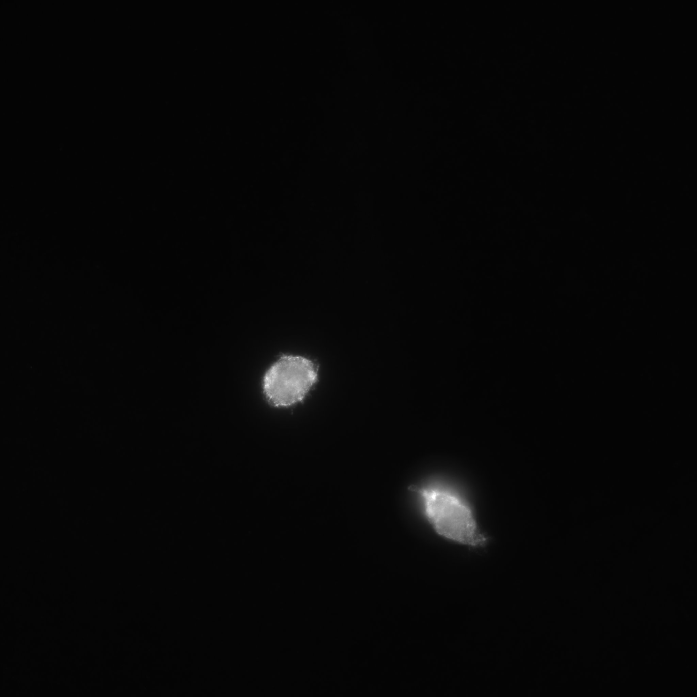
Figure 3
A
C
F-Actin/DAPI
Fibronectin
Paxillin
RGD
B
RSyn
IKVAV

Slide 4
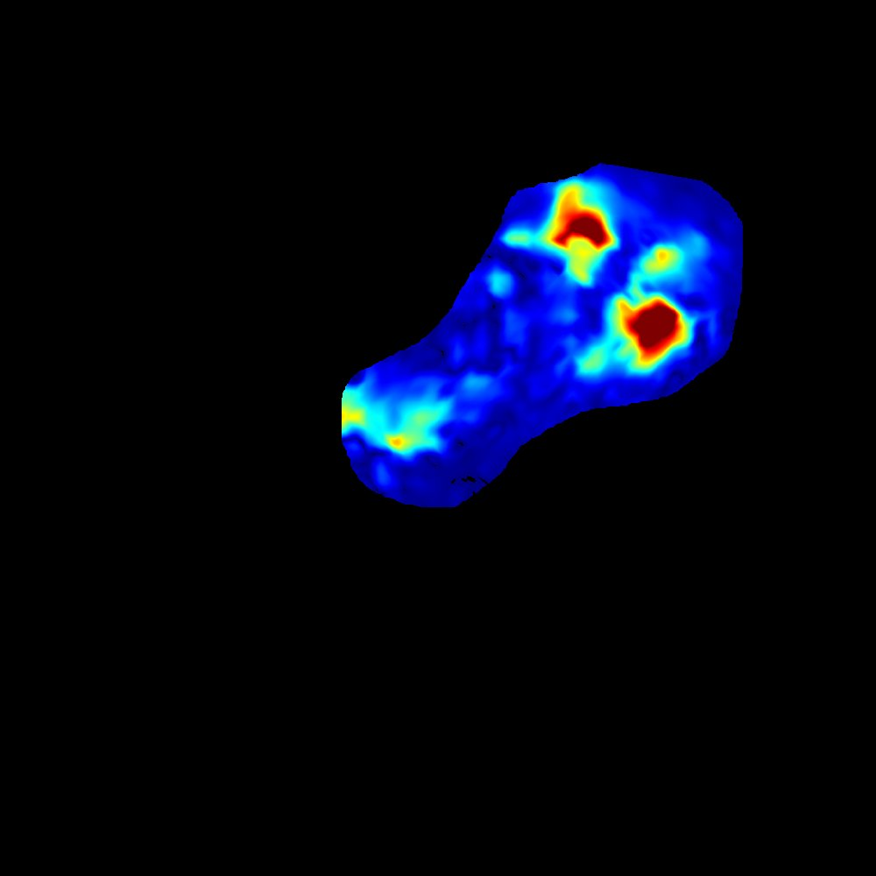
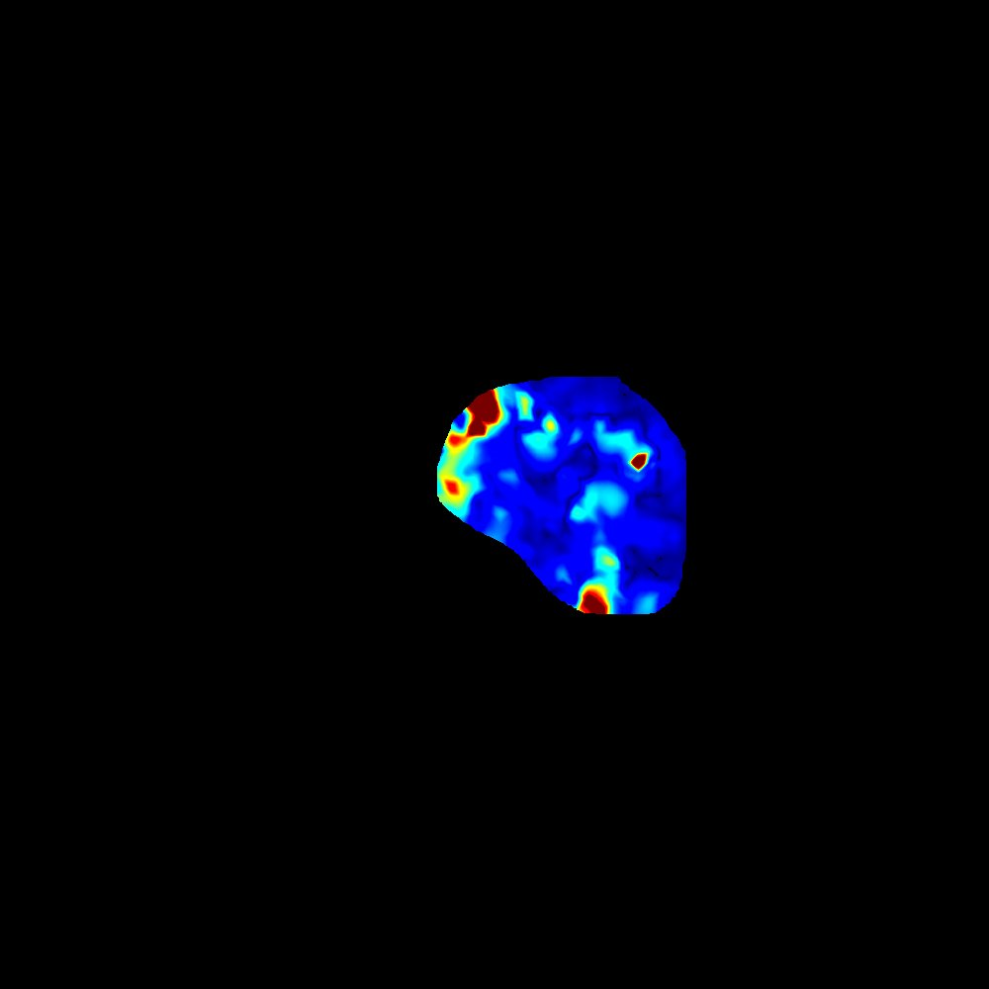
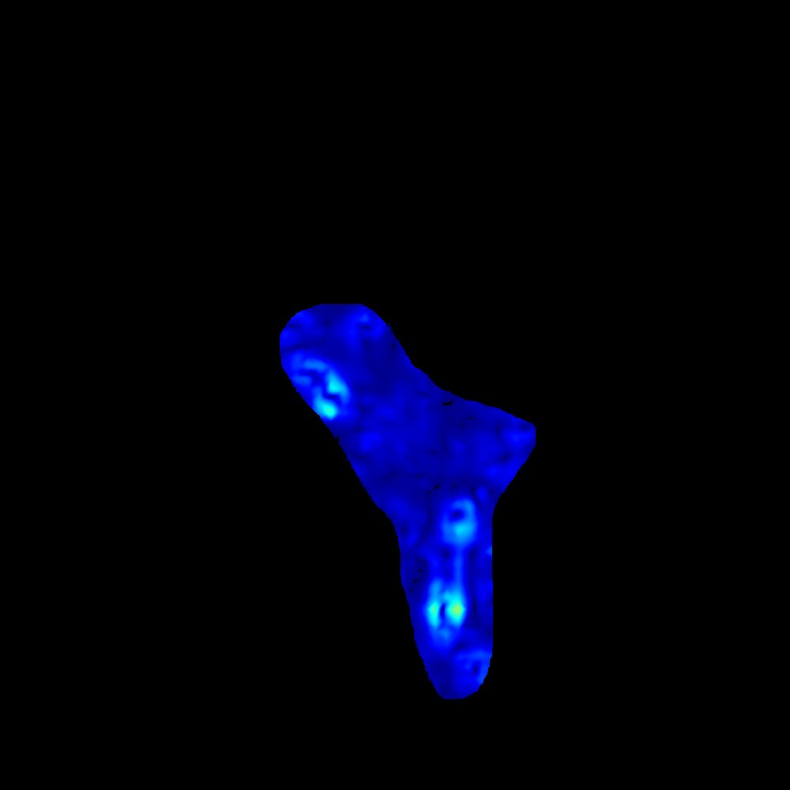
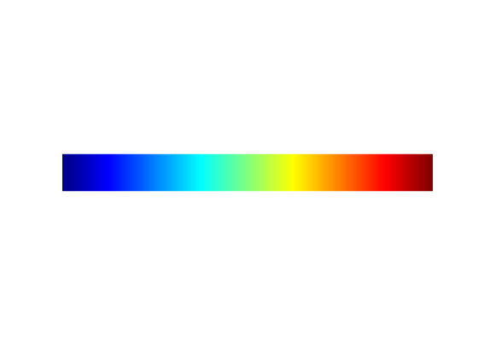
Figure 4
A
150
RGD
RSyn
IKVAV
B
Traction Stress (Pa)
0

Slide 5
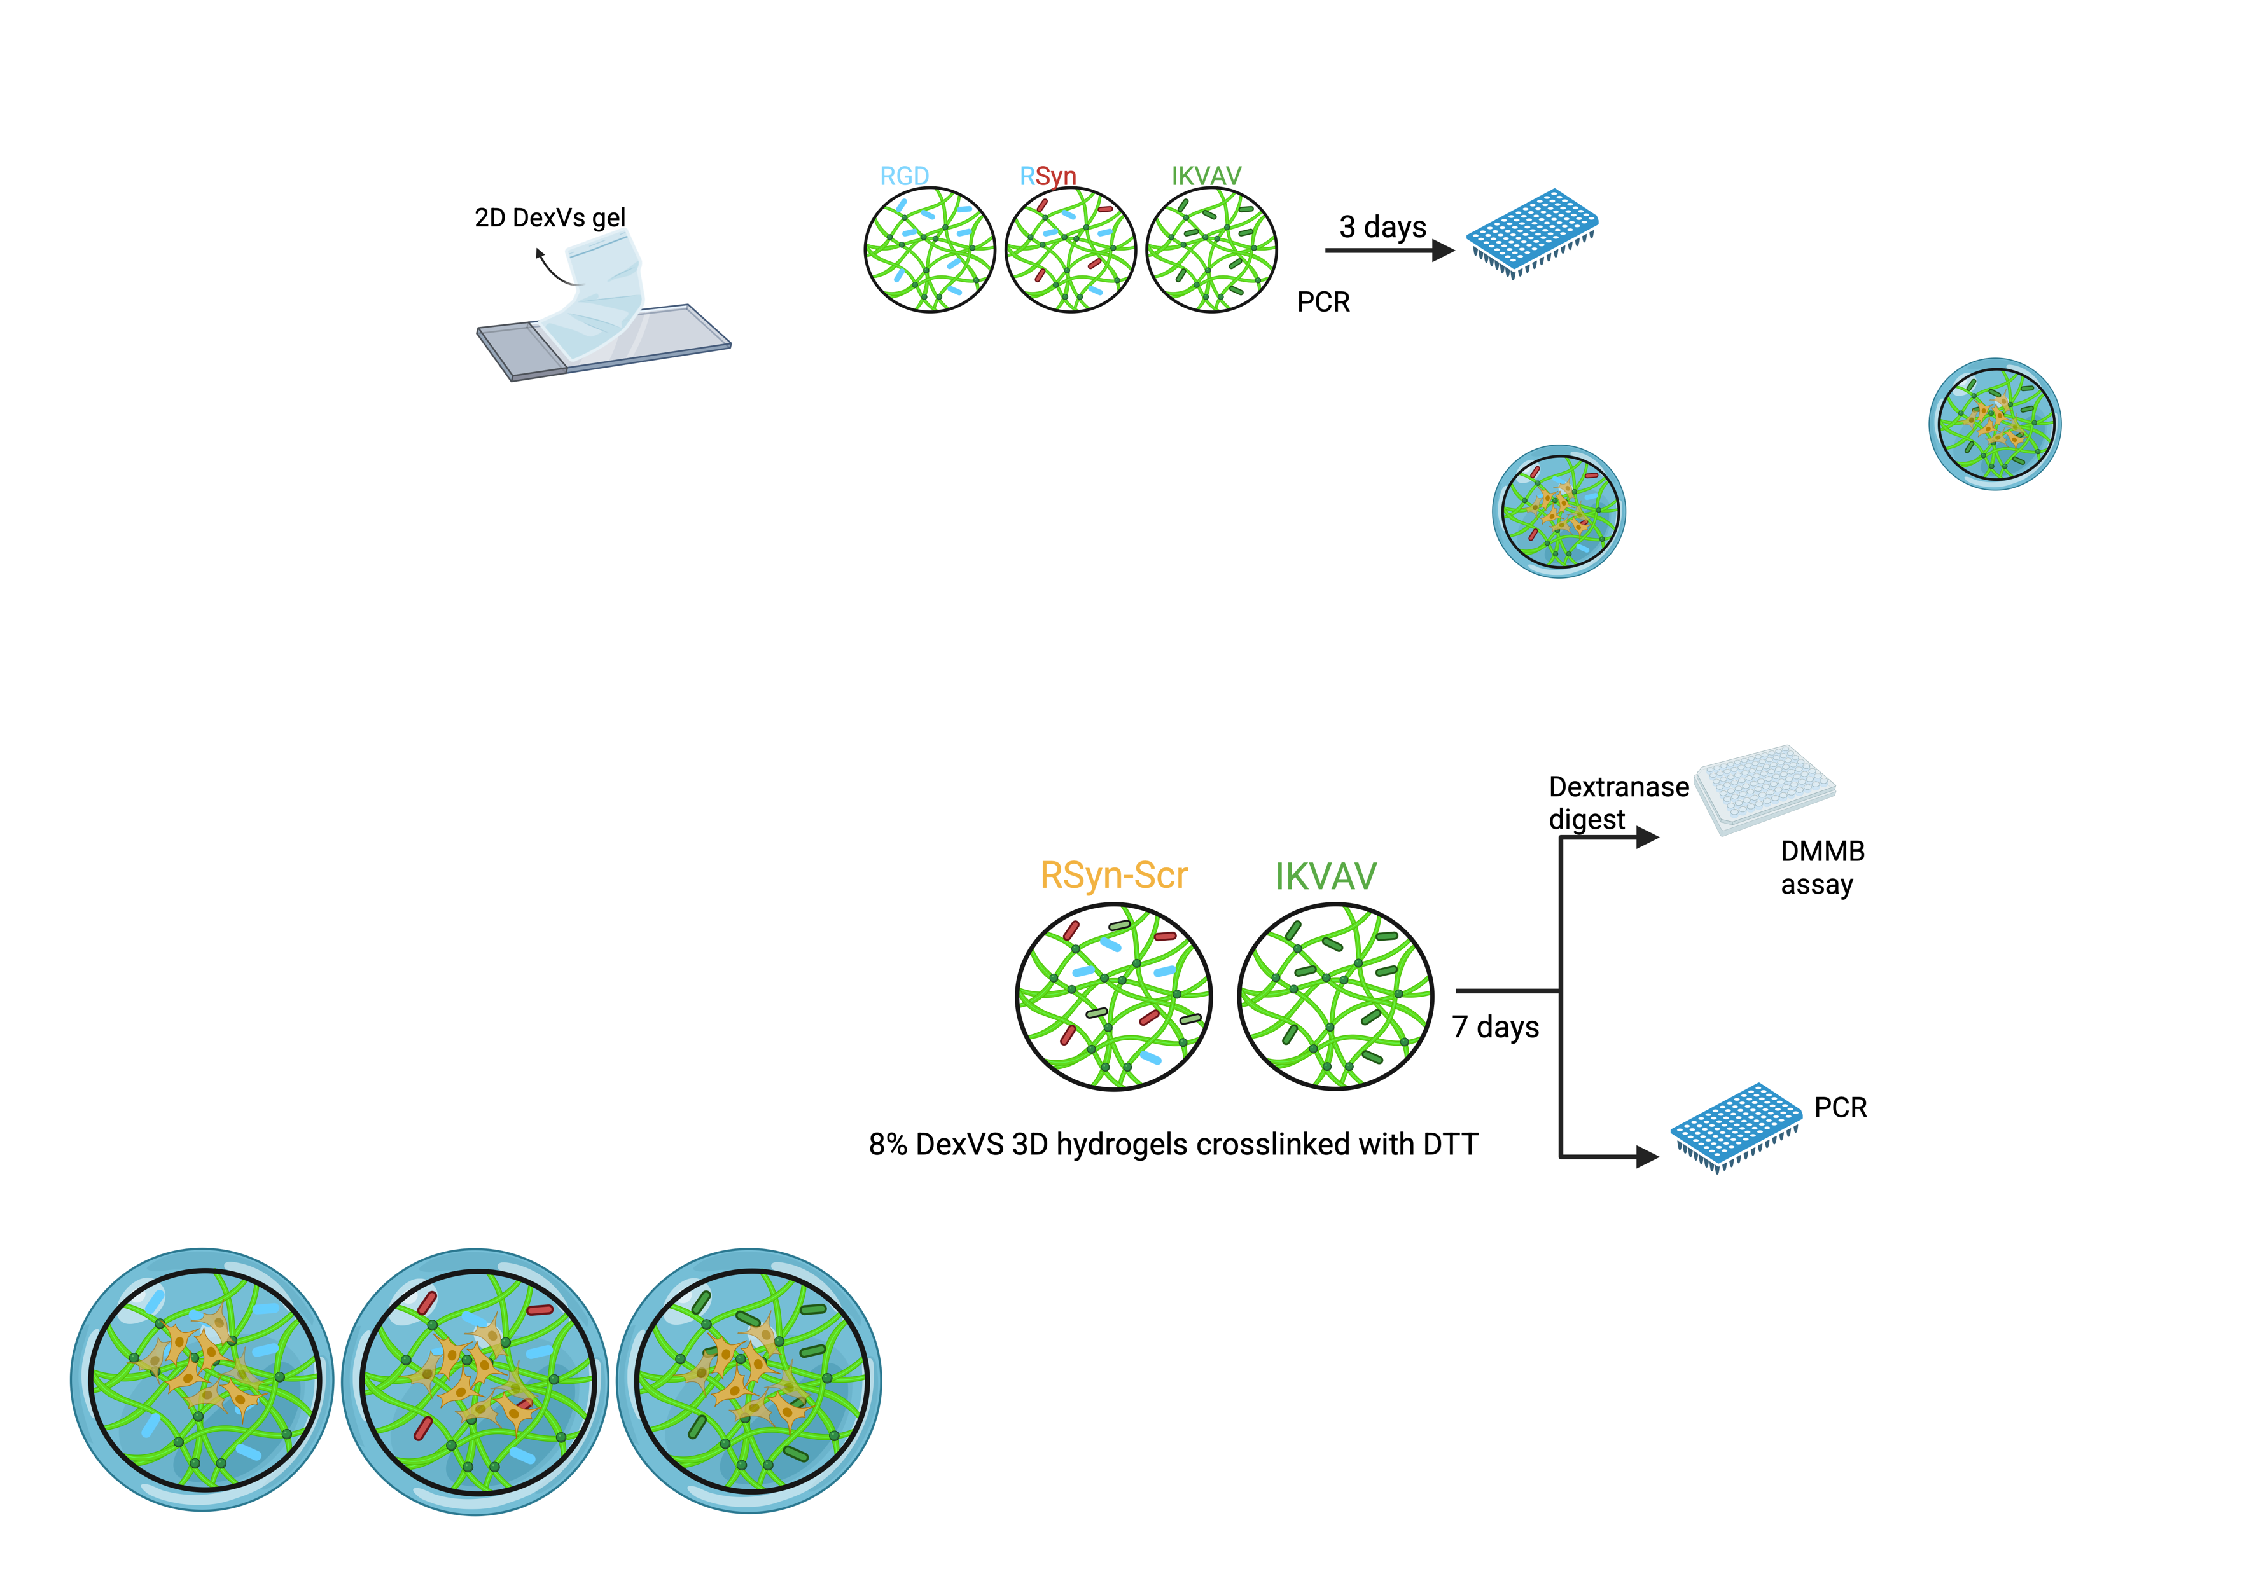
Figure 5
A
RGD
RSyn
IKVAV
B
C
D

Slide 6
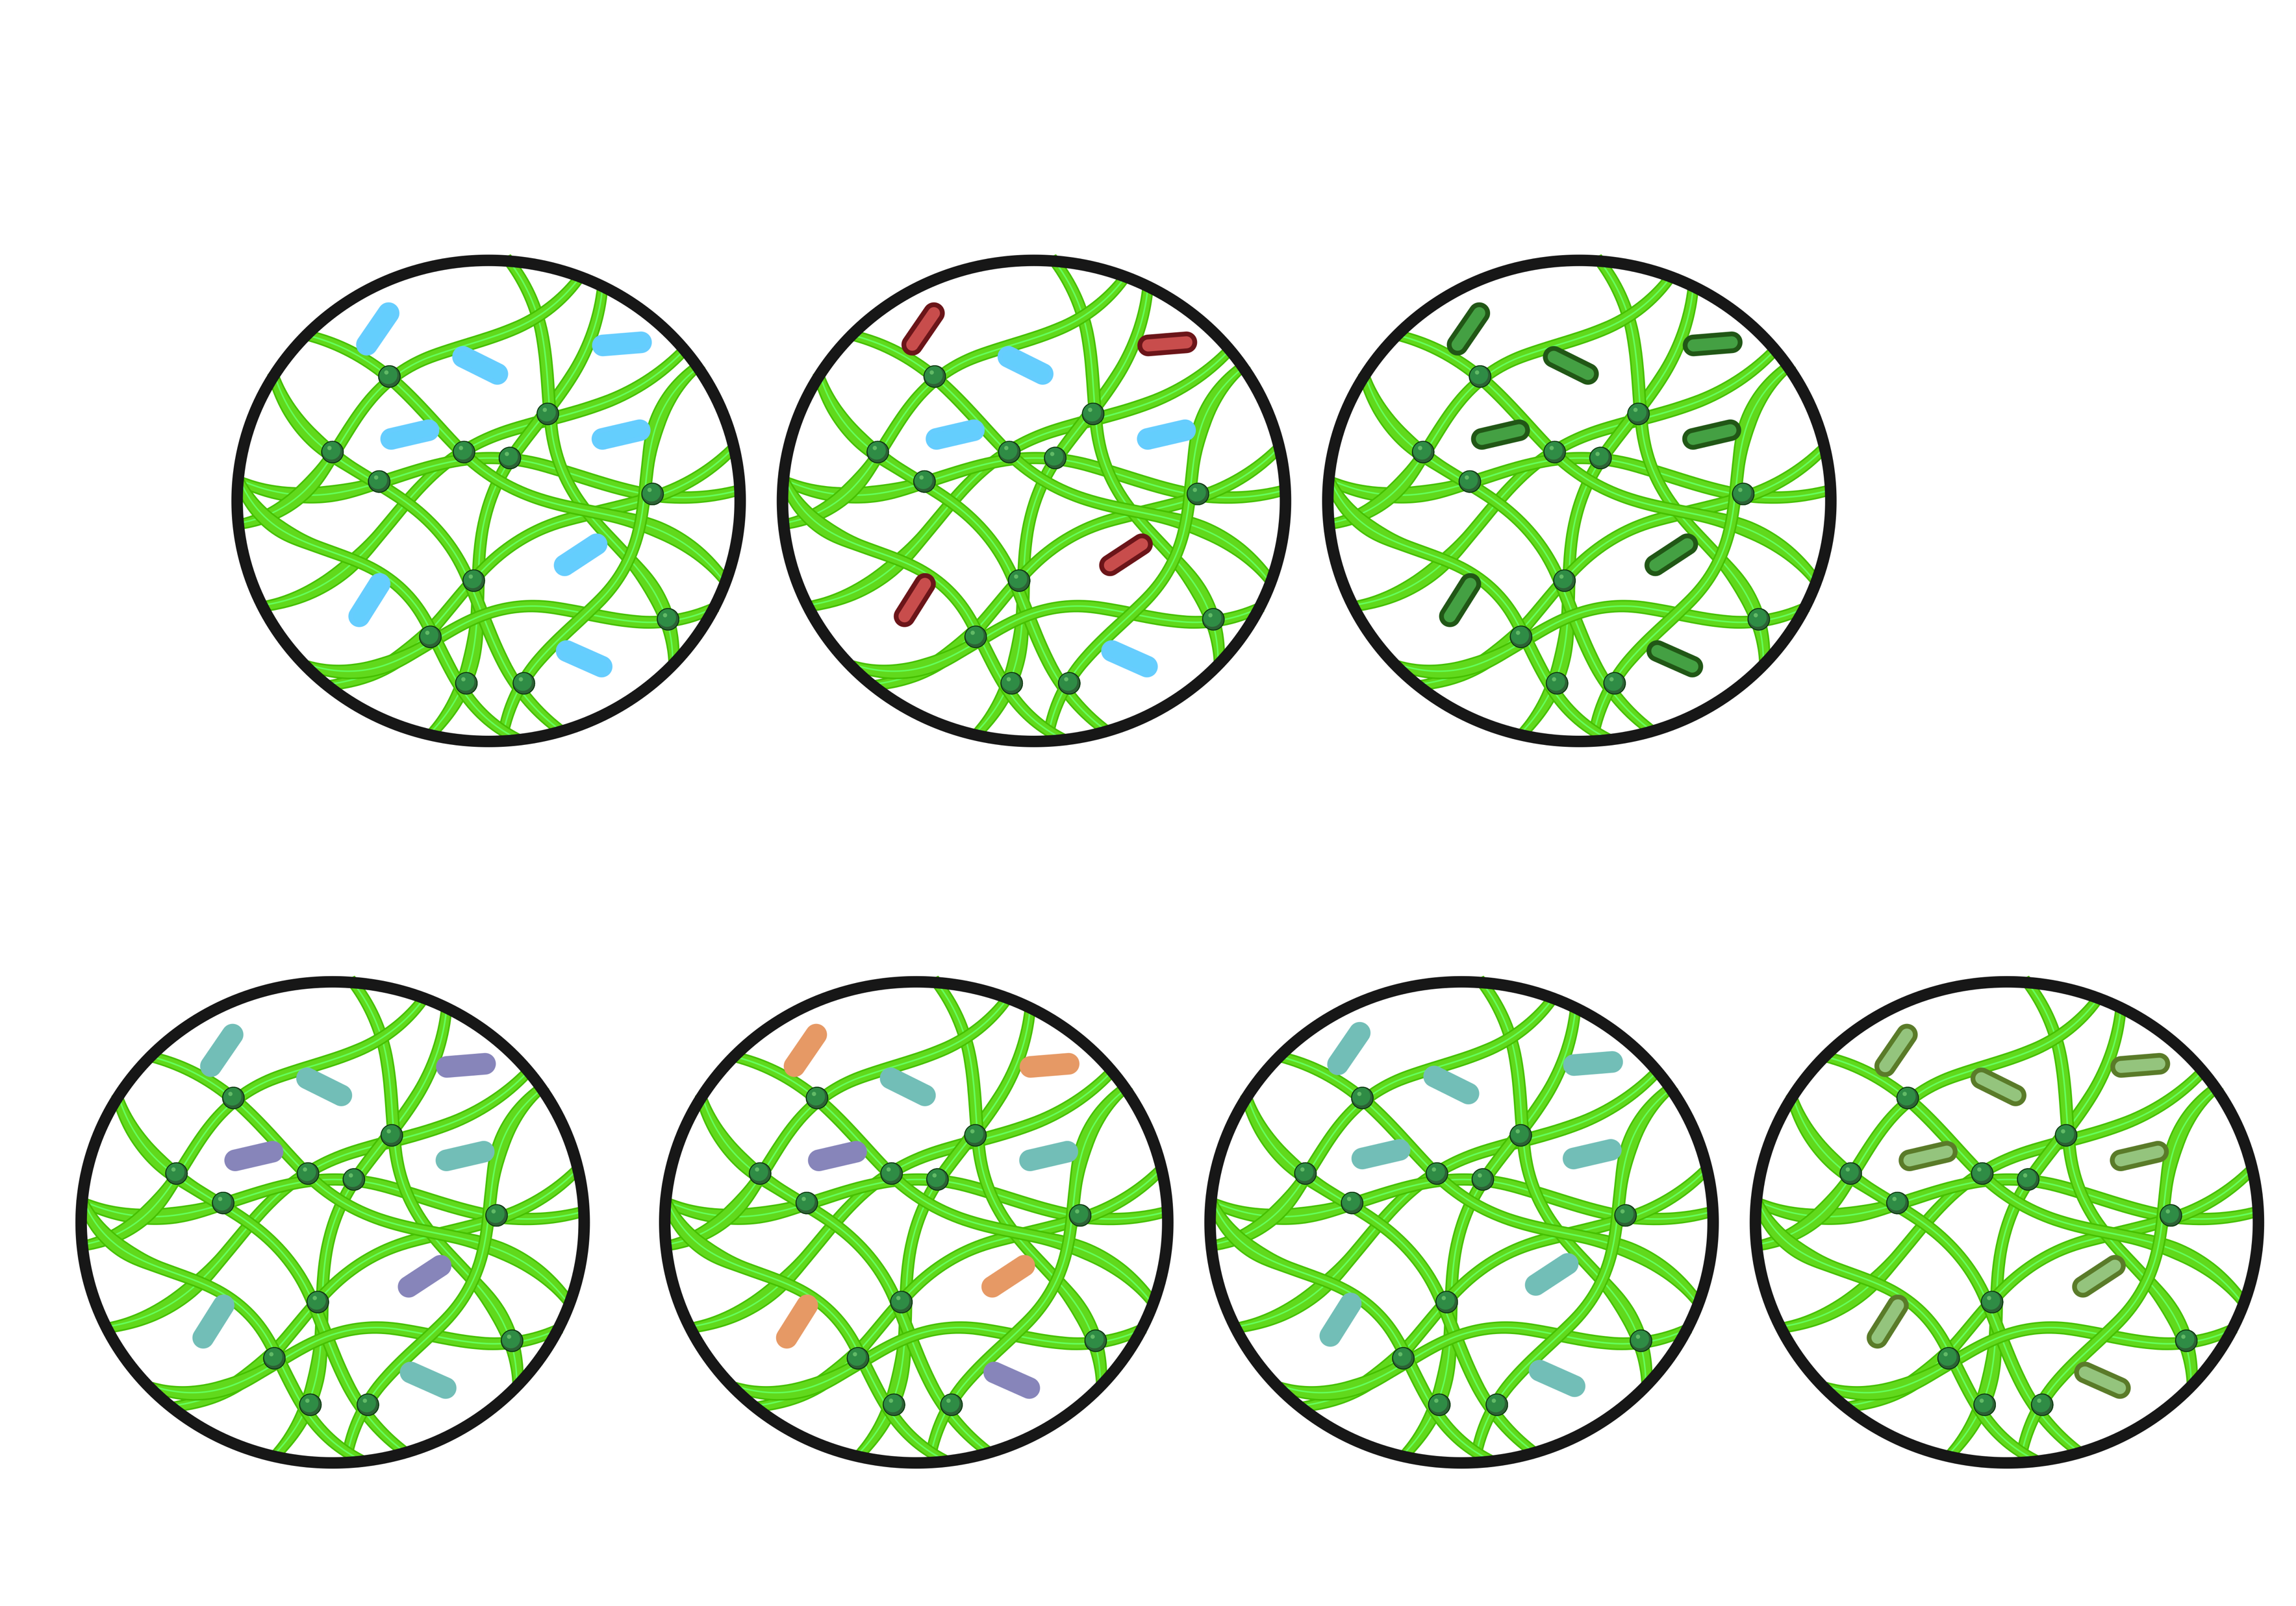
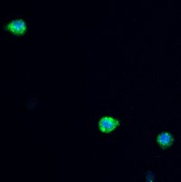
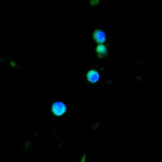
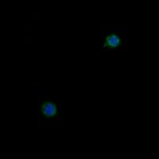
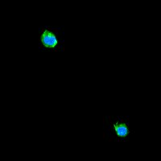
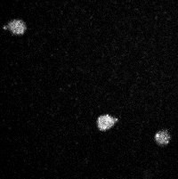
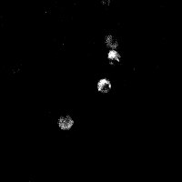
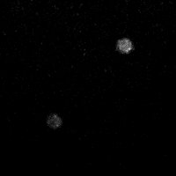
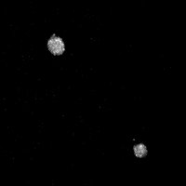
Figure 6
A
3D 8% DexVS Hydrogel
20mM DTT
B
RGD + Scramble
RGD + Synergy
+Scramble
Scramble
IKVAV
C
RScr
RSyn-Scr
Scr
IKVAV
D
F-Actin/DAPI
YAP

Slide 7
Supplemental Figure 1
A
B
Supplemental Figure 1: NMR spectrum of the Dextran complex after vinyl sulfone modification. Key peaks at 6.2, 6.4, and 6.9 ppm in D2O (highlighted in red, green, and yellow) correspond to hydrogens in the vinyl-sulfone. The anomeric proton of the glycopyranosyl ring (5.1 and 4.85) . The degree of modification was determined to be approximately 47%.

Slide 8
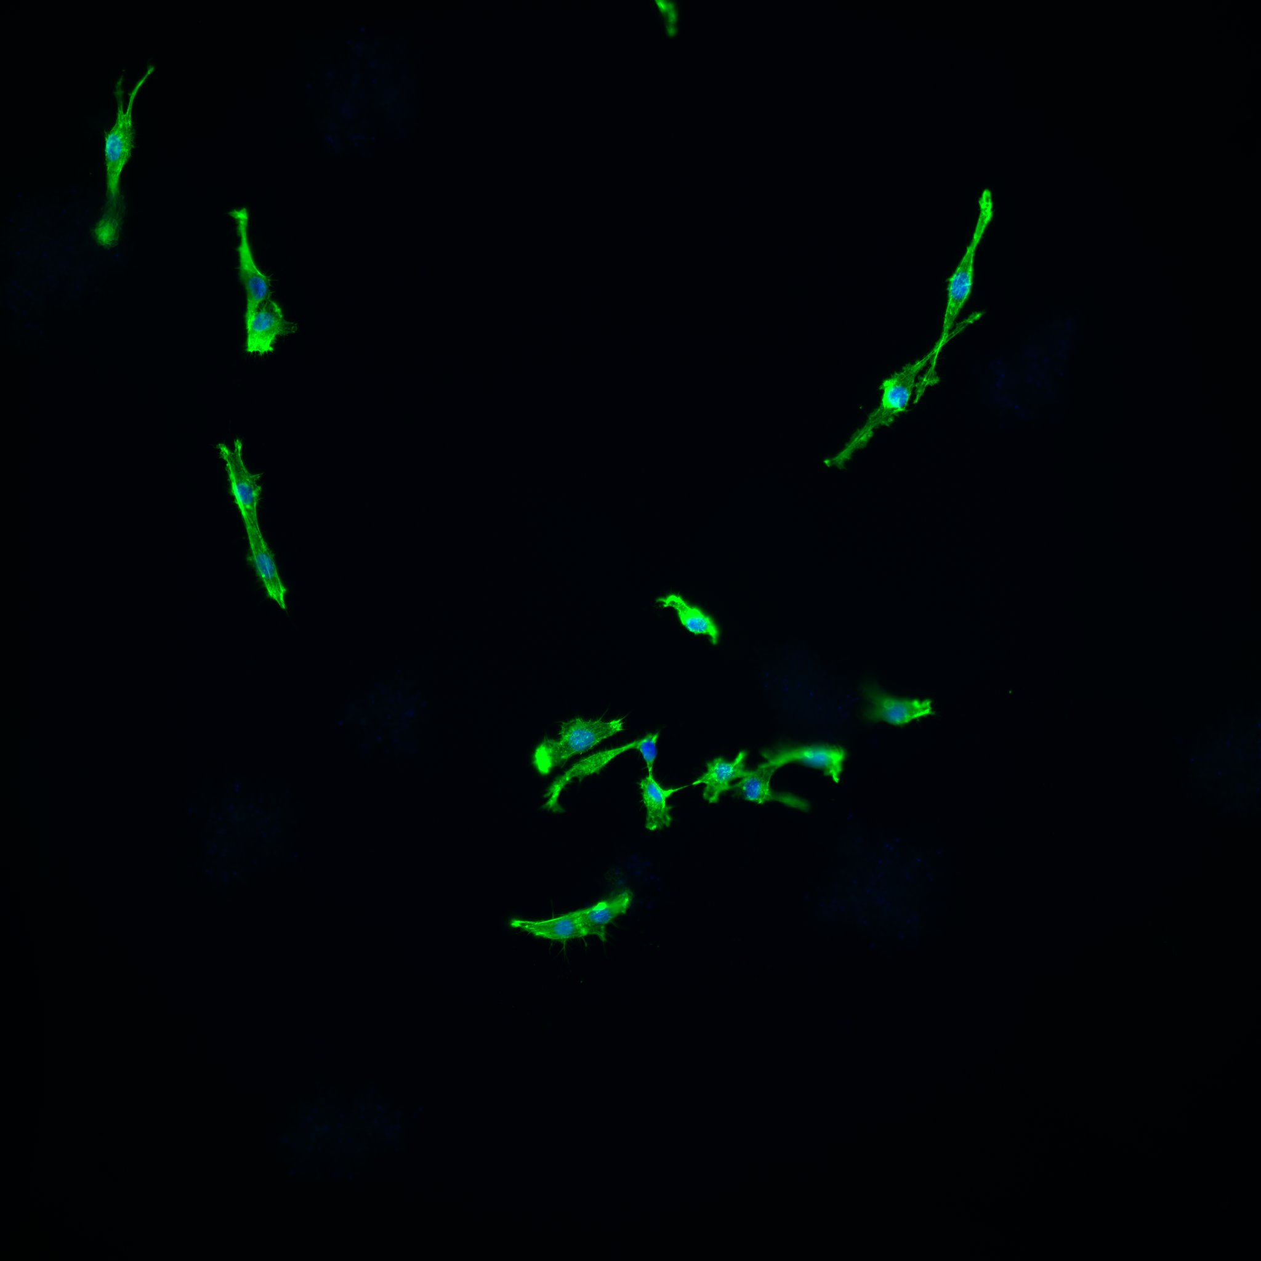
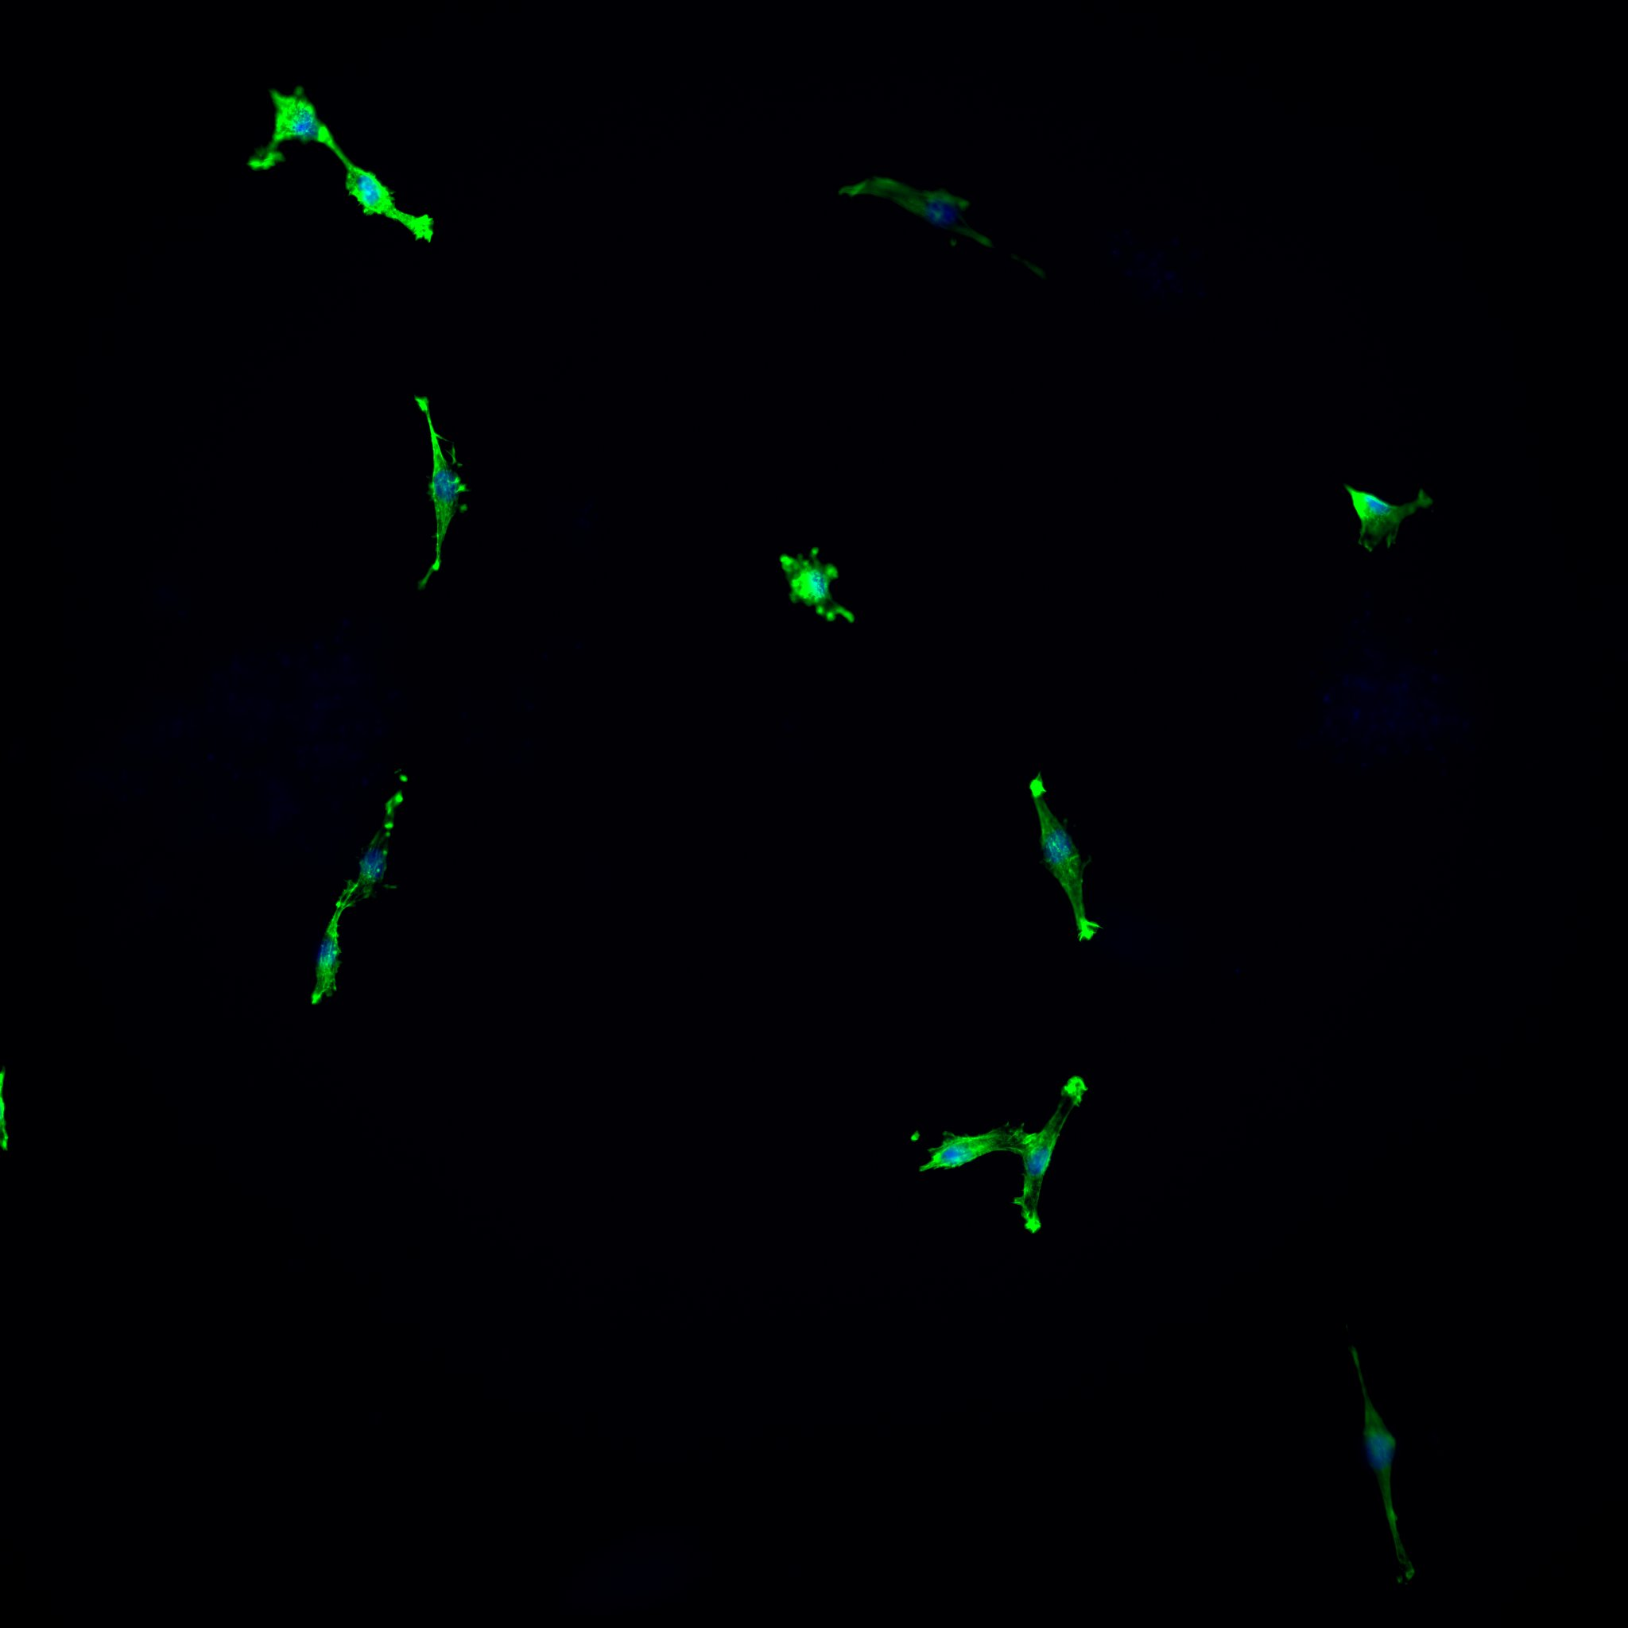
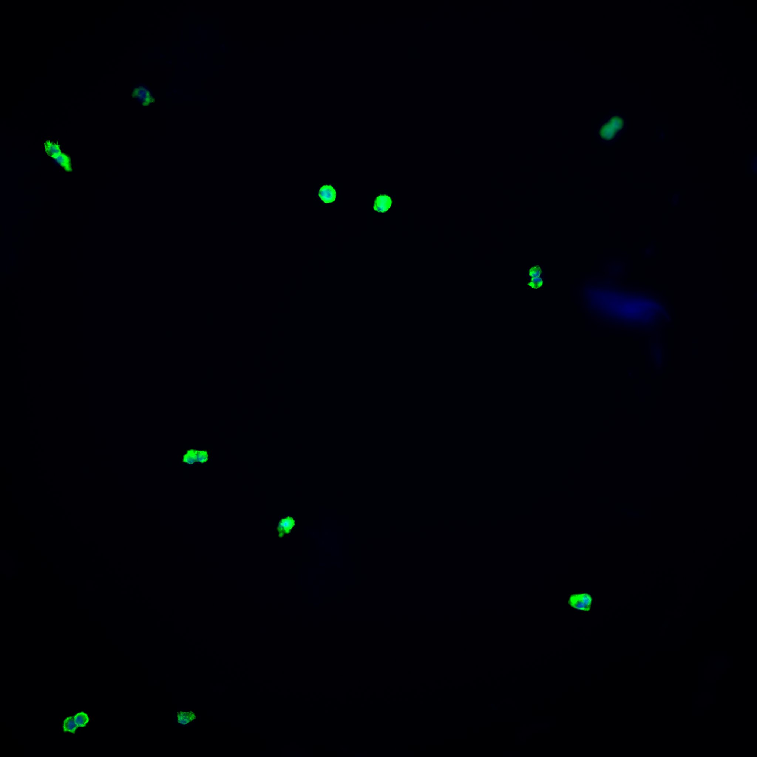
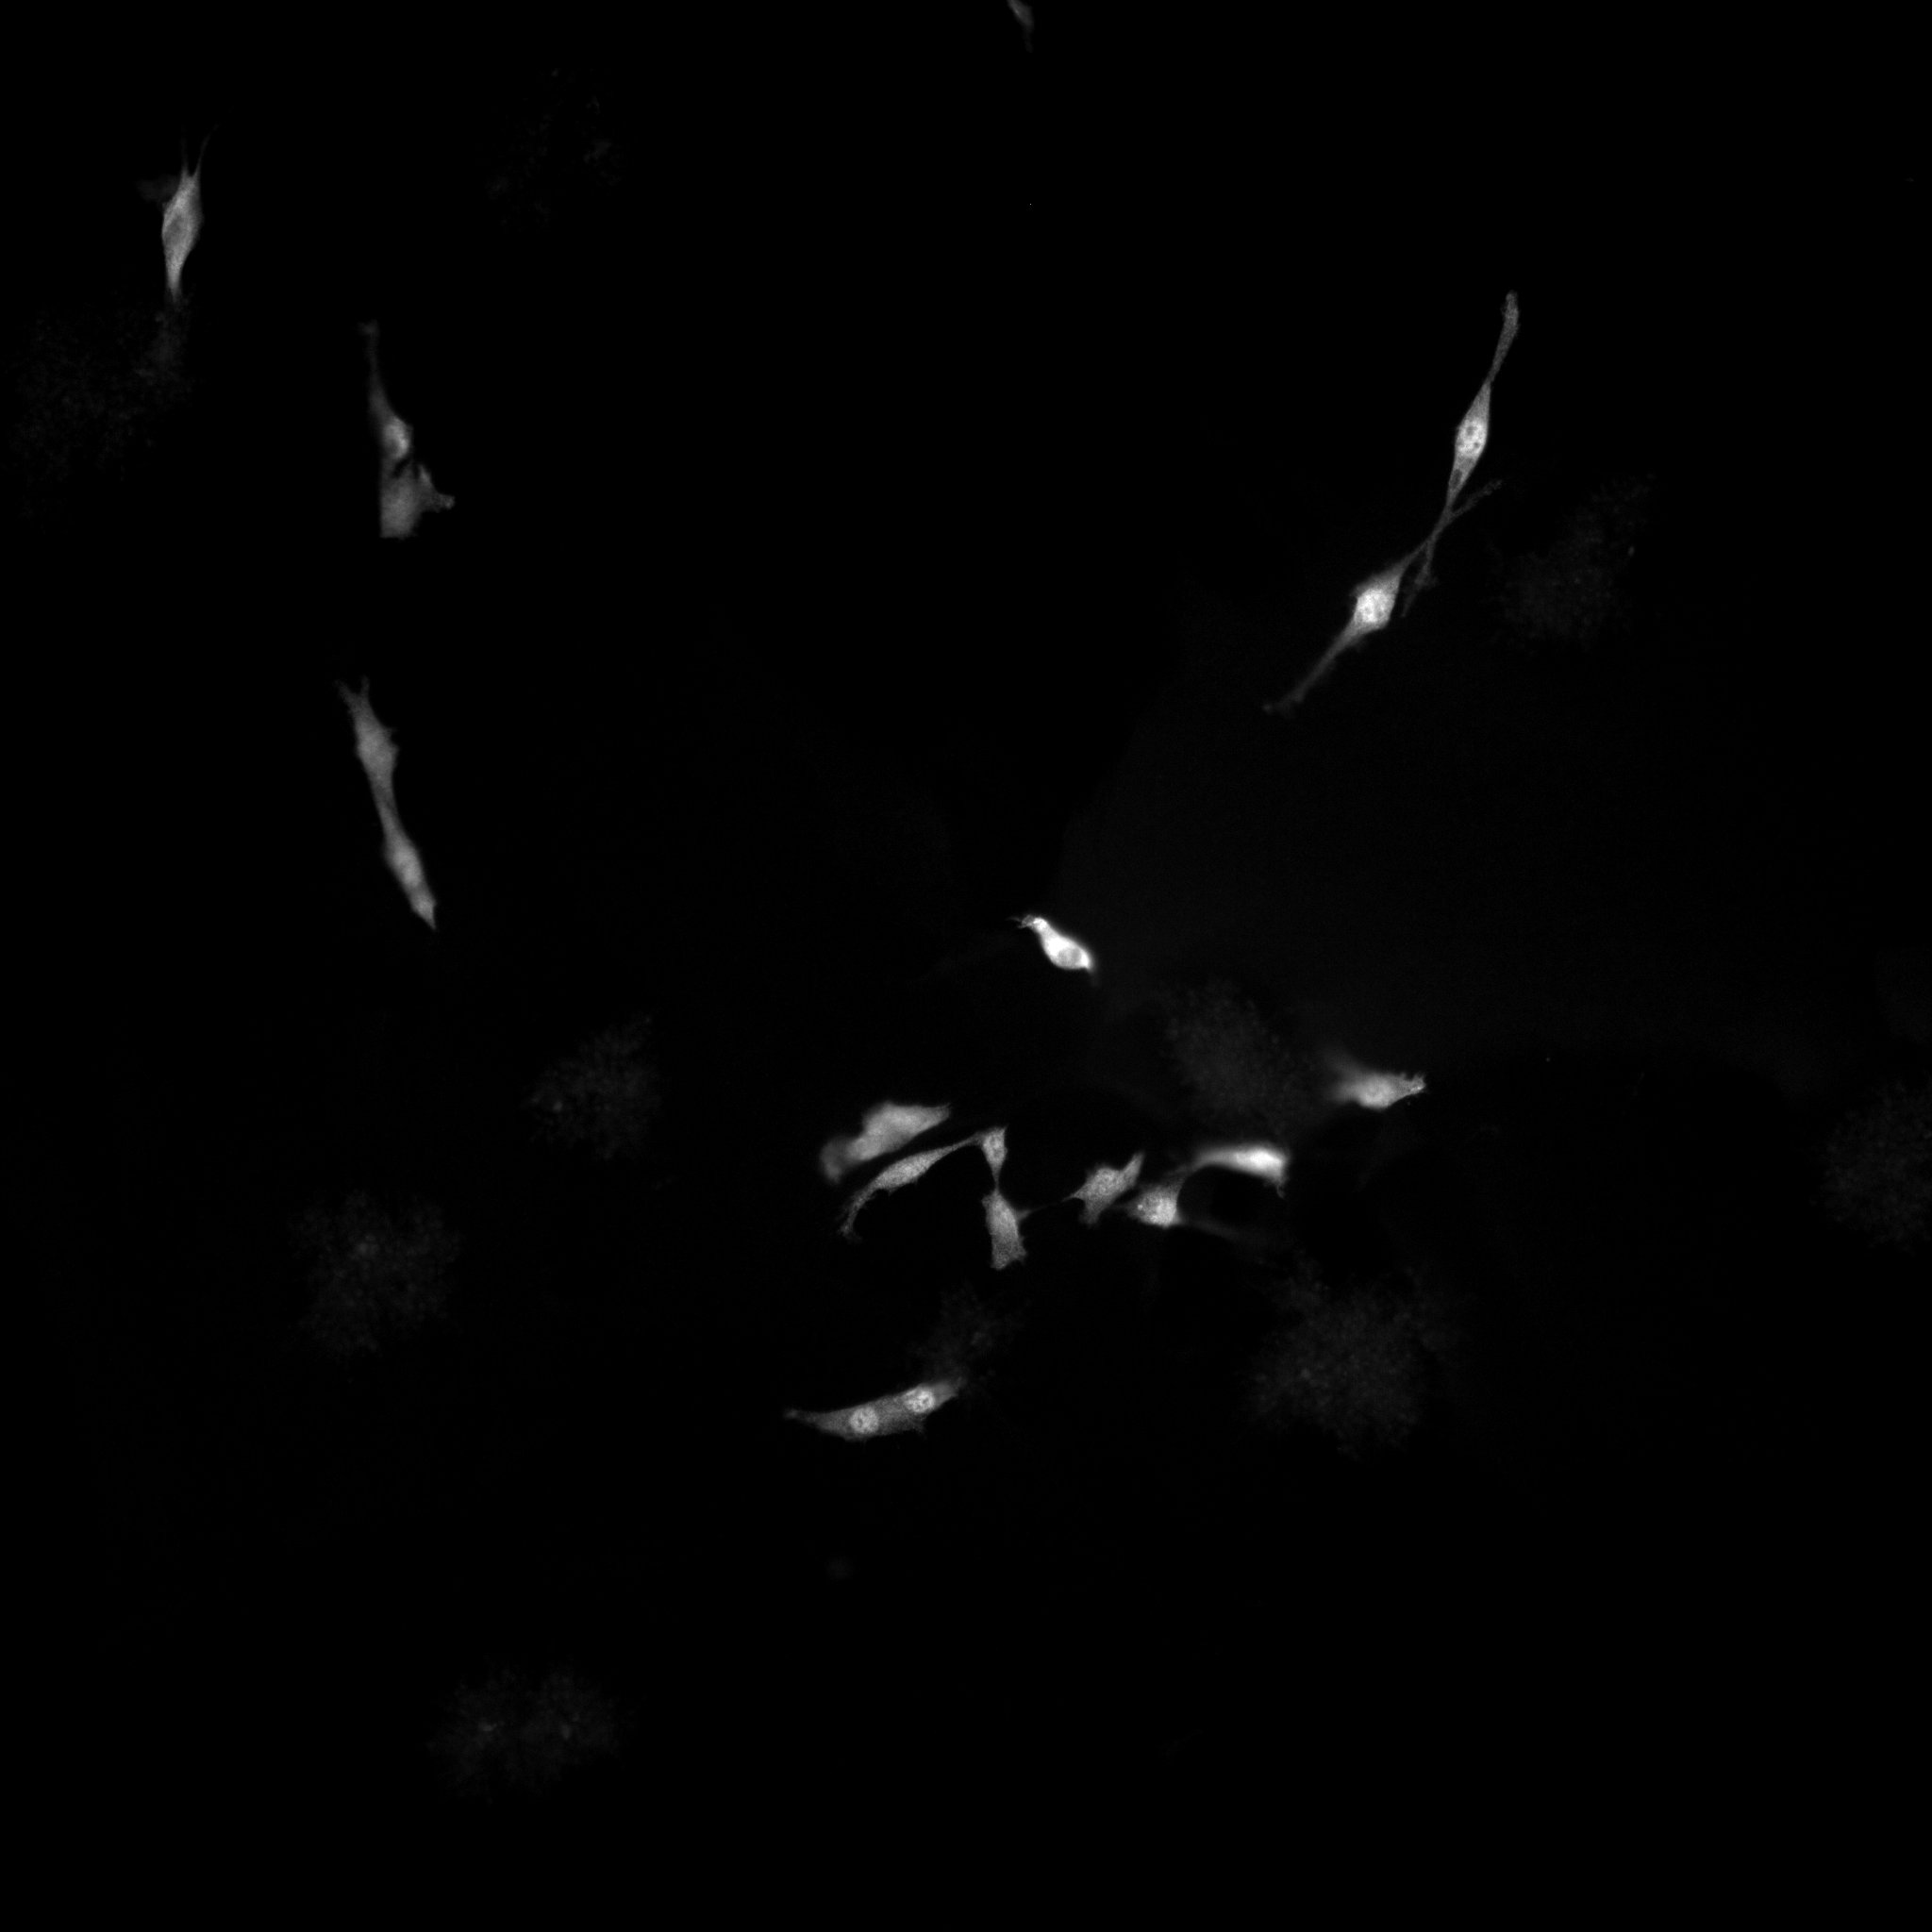
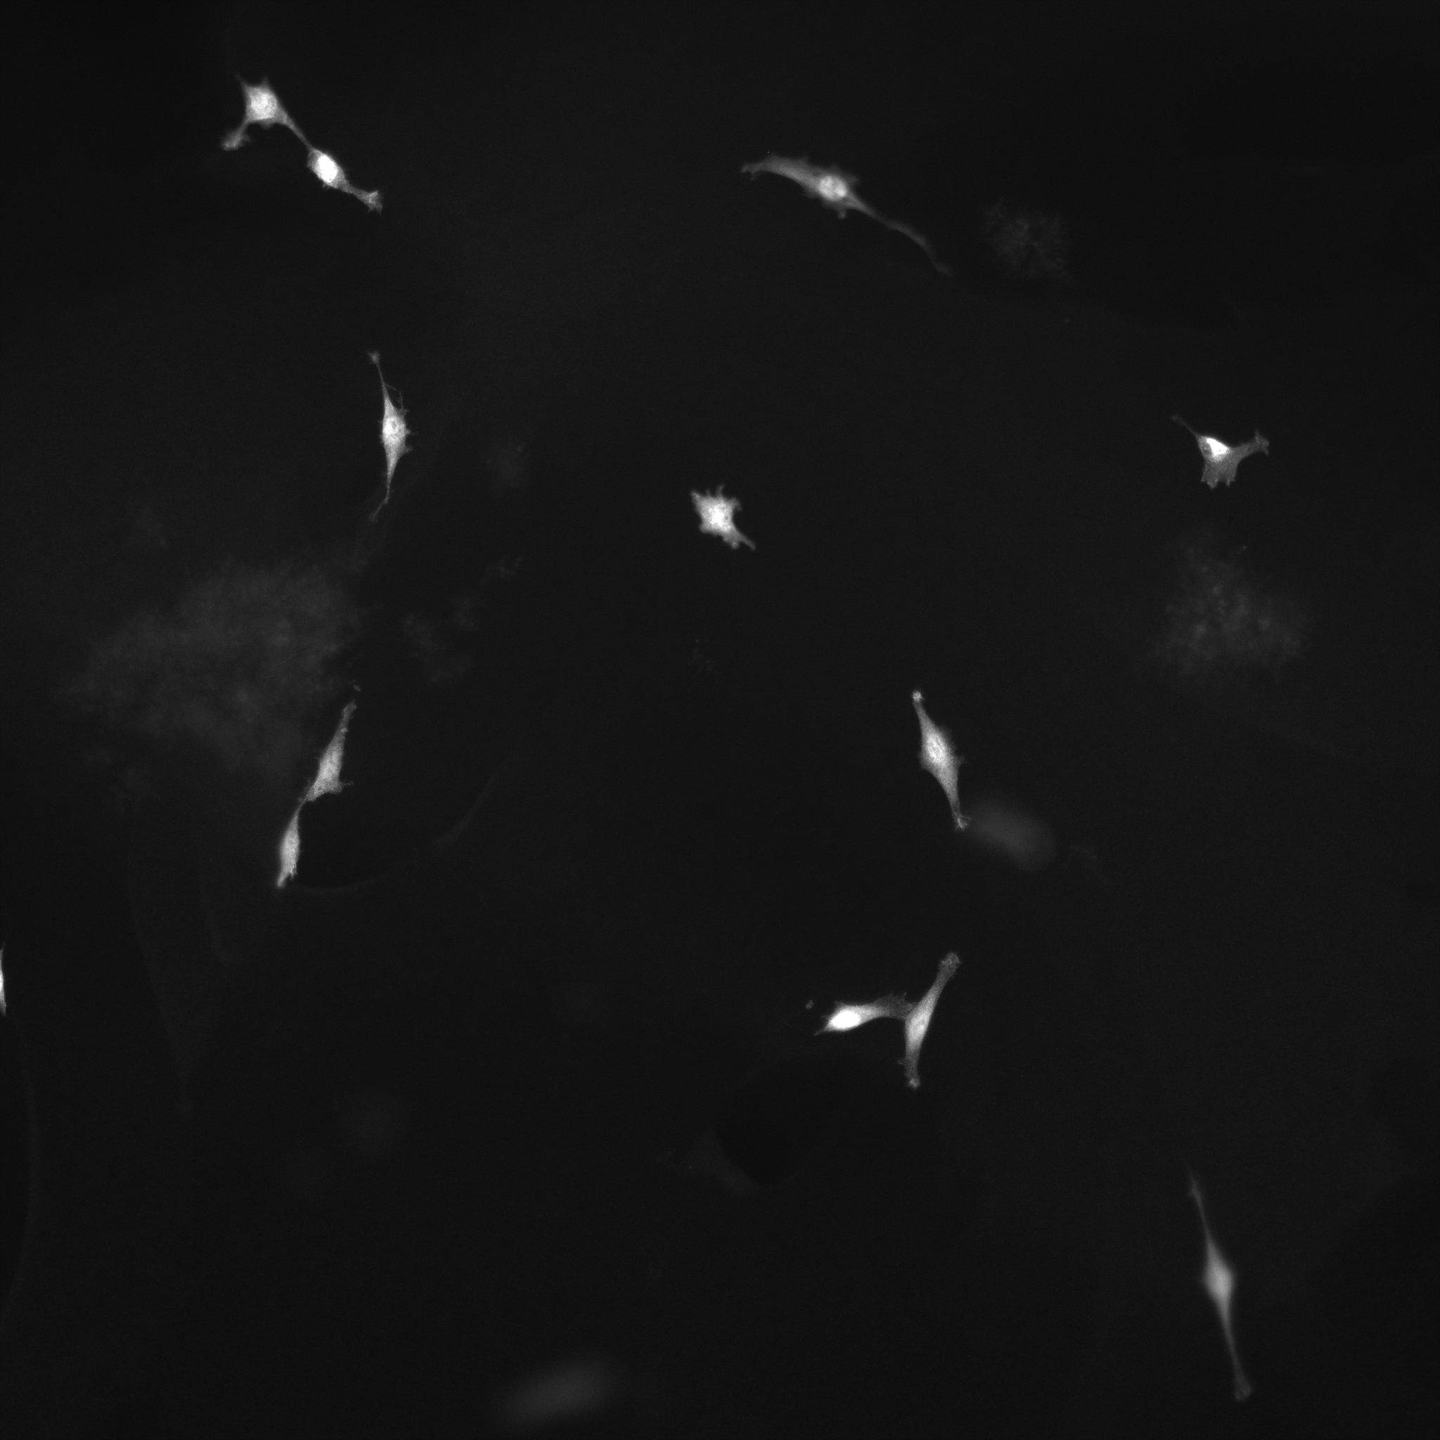
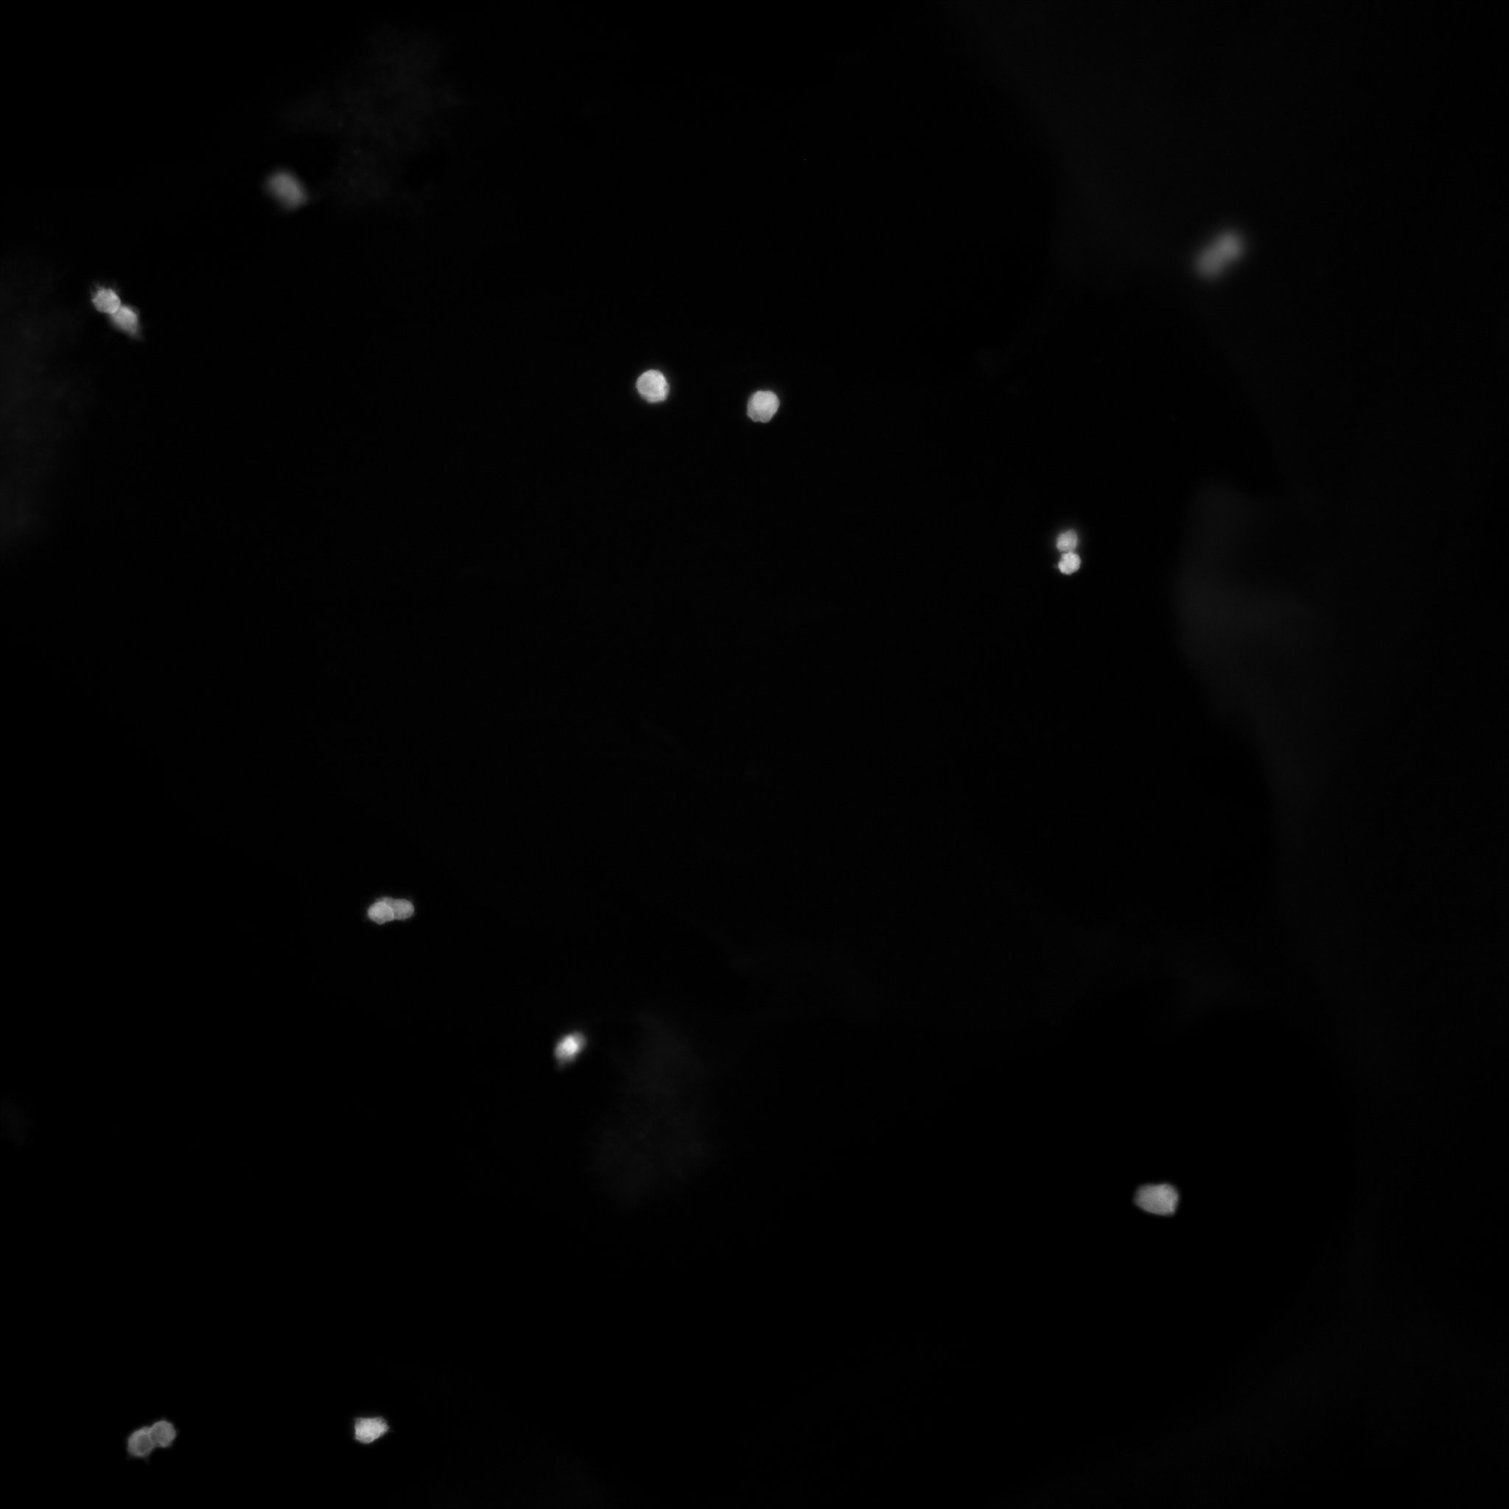
Supplemental Figure 2
A
B
RGD
RSyn
IKVAV
F- Actin/DAPI
YAP

Slide 9
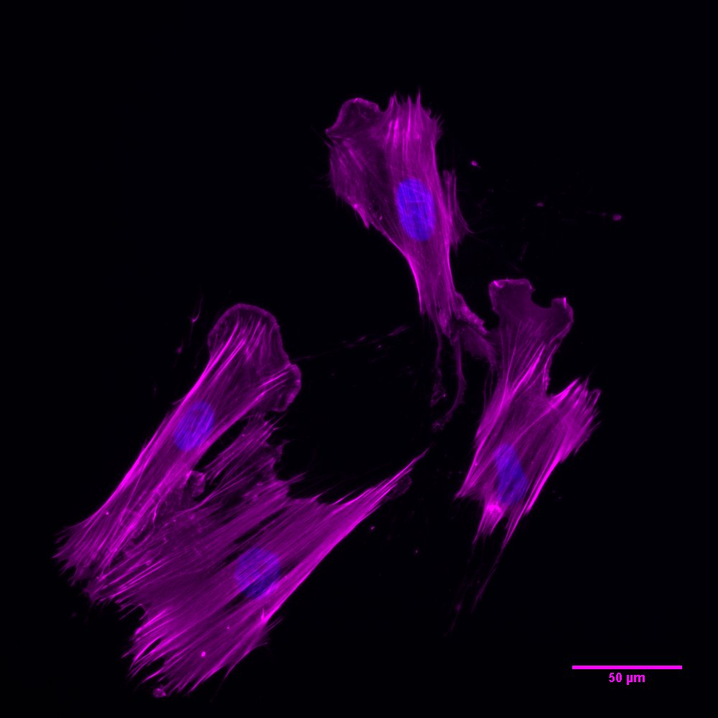
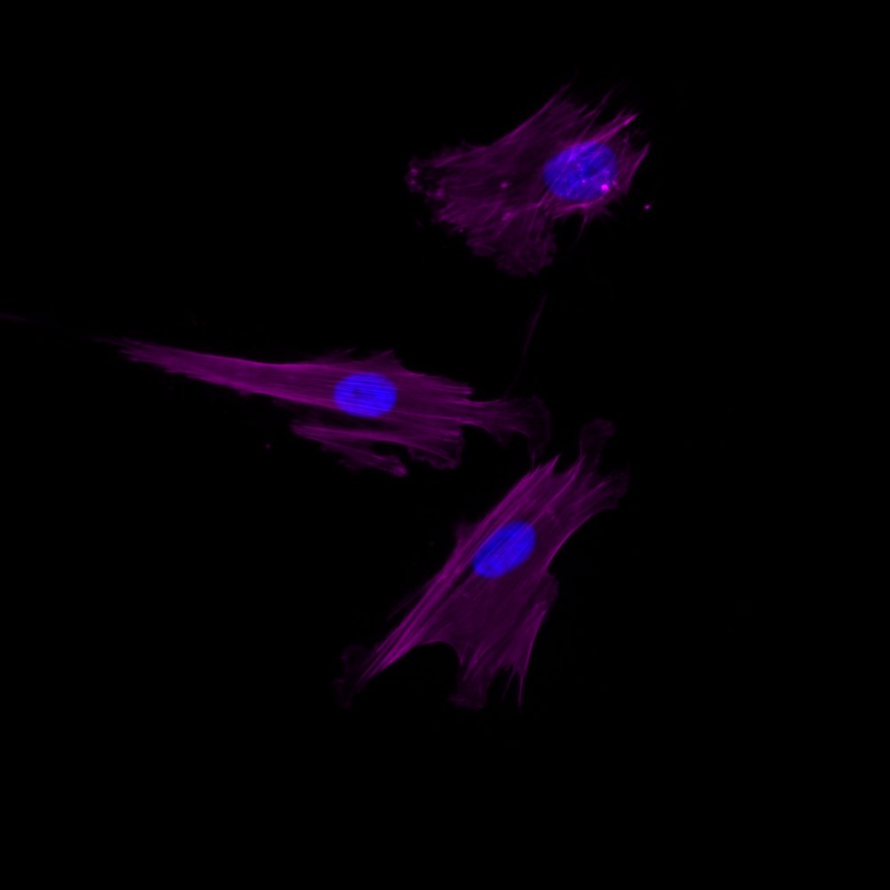
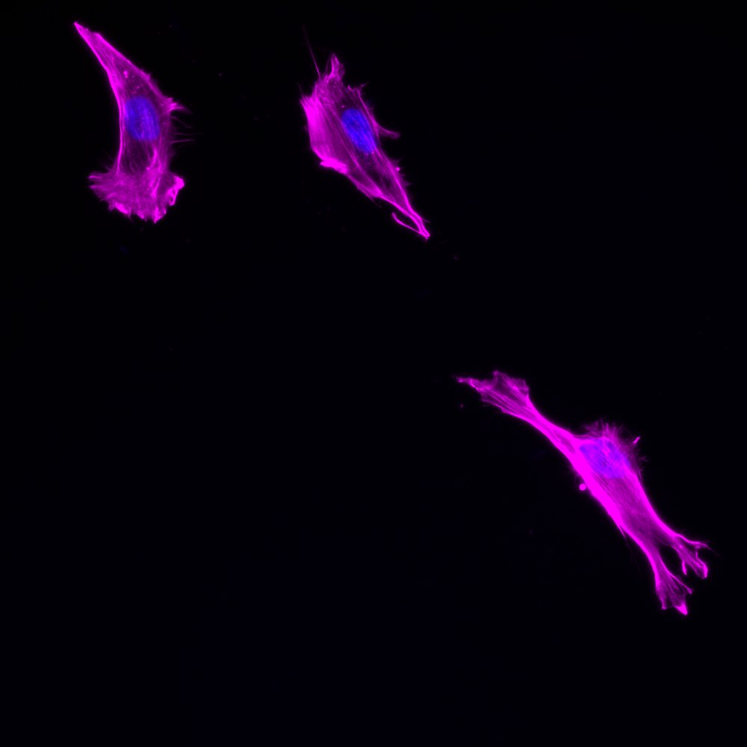
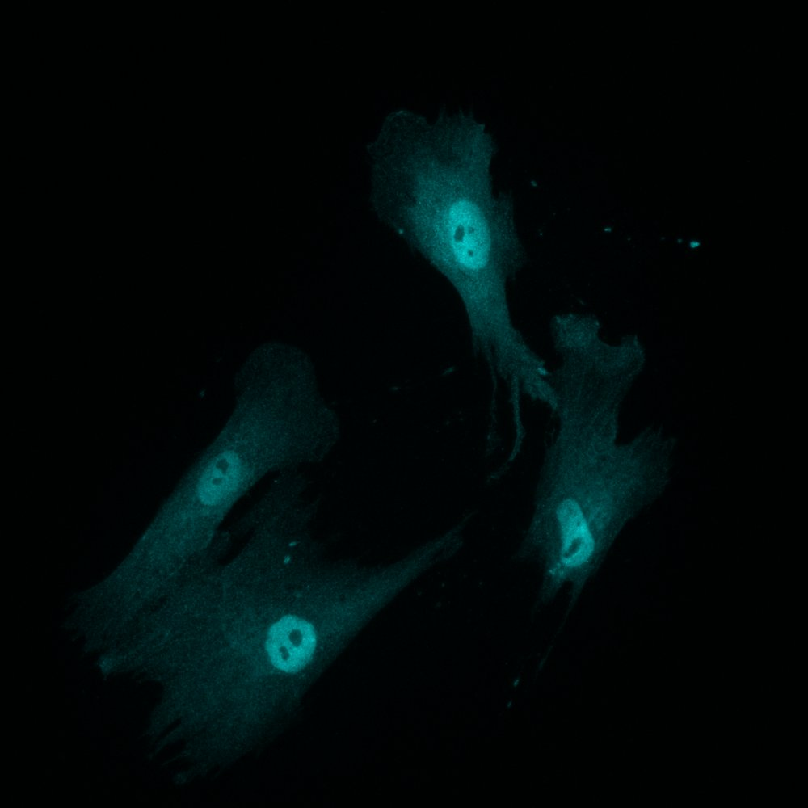
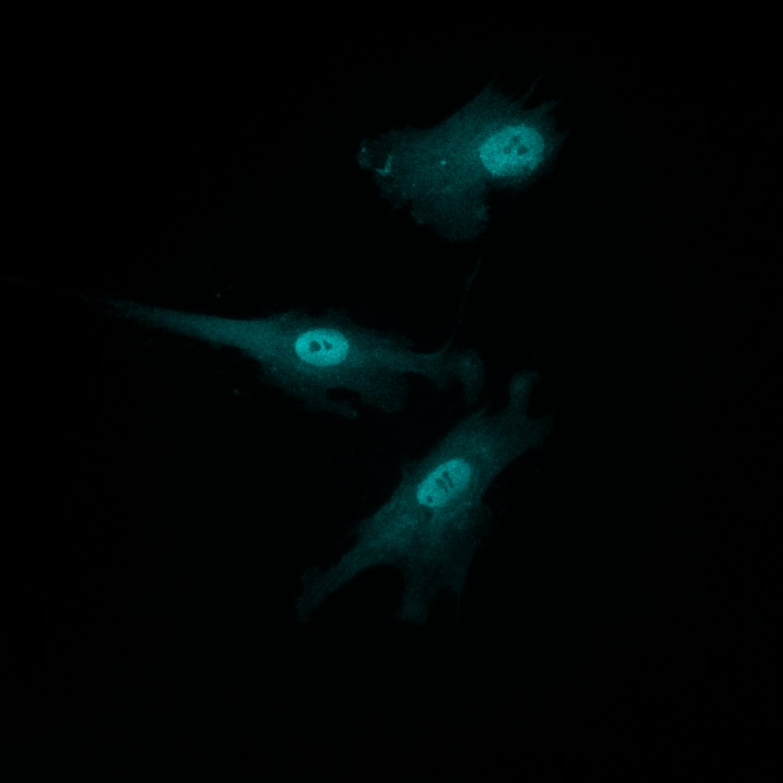
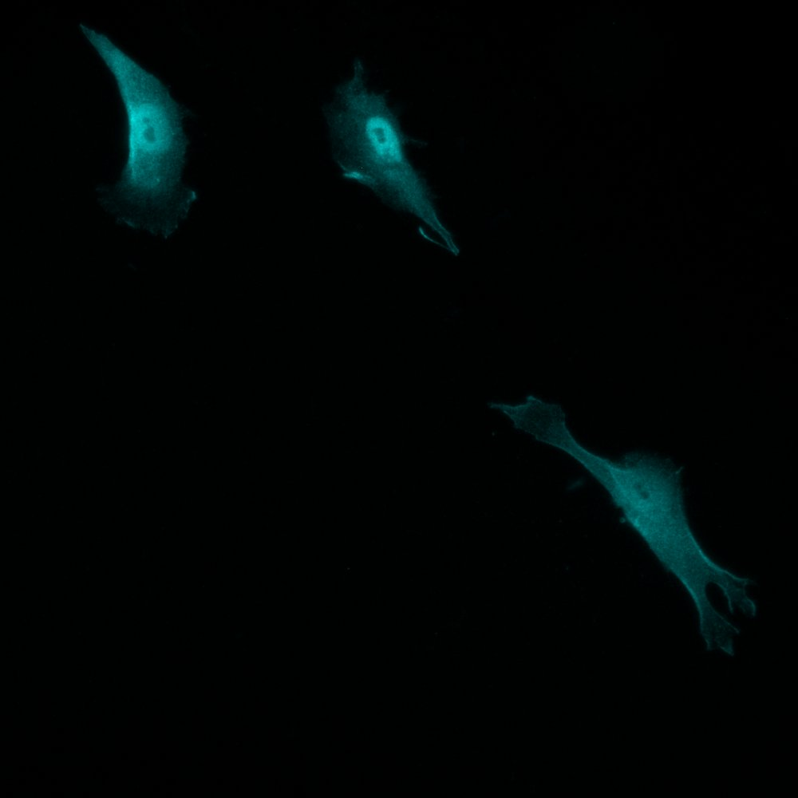












Supplemental Figure 3
A
C
RGD
RSyn
IKVAV
F-Actin / DAPI
YAP
B
p65
D
F
RGD
RSyn
IKVAV
F-Actin/DAPI
YAP
E
p65

Slide 10












Supplemental Figure 4
A
C
Col_Ctrl
LPS
IL-1β
TNFα
F-Actin/DAPI
B
YAP
p65

Slide 11





Supplemental figure 5
A
C
RGD
IKVAV
LIVE
B
DEAD

Slide 12
Supplemental Extra
A
B
C
D
E
F

